Slide 1
Modélisation du déplacement en Capture-Recapture
R. Pradel, CEFE/CNRS
Notes:
Thème très présent dans les travaux de l’équipe

Slide 2
Capture-Recapture historique du courant principal
Suivi individuel en temps discret (Cormack 1964)
Plusieurs sites (Arnason 1973, Hestbeck et al. 1991)
Modèles à mémoire (Brownie et al. 1993, Pradel et al. 2003, Rouan et al. 2009)
Modélisation du mouvement (Morales et al. 2004, McClintock et al. 2012)

Slide 3
Capture-Recapture autres pistes
Modèles de densité (Borchers et Efford 2008, )
Domaine d’activité linéaire (poisson en rivière, Danancher et al. 2004)
Etats comportementaux (Avril 2012)

Slide 4
Plan exposé
Une étude classique
Principe du modèle de description du mouvement de Morales et McClintock
Le test de mémoire
Une étude atypique: domaine d’activité linéaire (poisson en rivière, Danancher et al. 2004)
Le mouvement ramené à des états comportementaux (Avril 2012)

Slide 5




TO LEAVE OR NOT TO LEAVE: SURVIVAL TRADEOFFS BETWEEN DIFFERENT MIGRATORY STRATEGIES IN THE GREATER FLAMINGO
Journal of animal Ecology, 2012
MATERGLOBE
© Nicolas Van Ingen
A. Sanz Aguilar, A. Béchet, C. Germain, A.R. Johnson & Roger Pradel

Slide 6
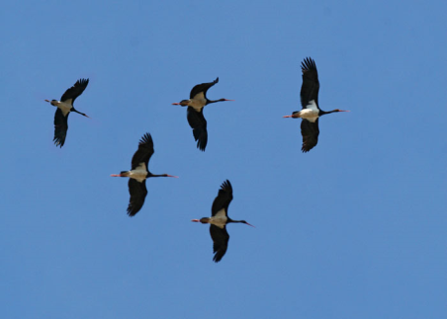
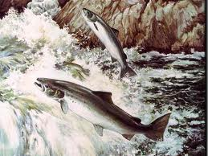
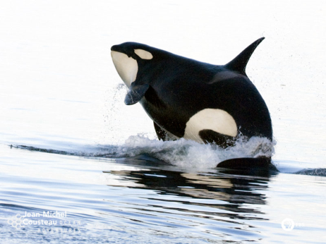
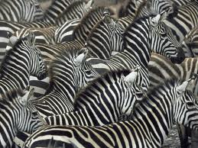
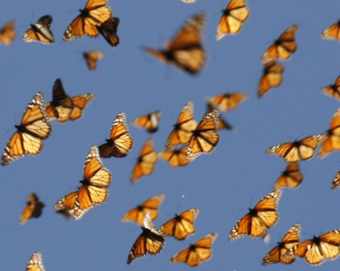
Wintering migration
Wintering migration is widely recognized as an adaptation to spatiotemporal fluctuations of resources and a response to environmental adversity.
However, the benefits may be balanced by costs associated with the migratory process:
    energy expenditure
    predation risks
    …
(Alerstam et al 2003; Dingle & Drake 2007)
Notes:
Migration is a common phenomenon among many animal taxa that plays a central role in the spatial dynamics of mobile populations
Migration is widely recognized as an adaptation to spatiotemporal fluctuations of resources and a response to environmental adversity
By using the most seasonally suitable habitats at each moment in their life cycle individuals may improve their fitness
However, the benefit of increased resource availability and avoidance of harsh climatic conditions may be balanced by costs associated with the migratory process. Migratory individuals traveling extensive distances often face increased risks compared with residents due to predation, exposure to variable parasite faunas and/or energetic costs of movement.
In addition, among dense populations, individuals arriving early in the season to breeding areas could benefit from a higher breeding success due to intense intraspecific competition for high quality breeding territories or mates.
The inter-individual variation in the costs and benefits of migration linked to environmental heterogeneity and behavioral plasticity may promote a broad range of migratory strategies within a population.
In many animal populations (including insects, fishes, mammals and birds) the seasonal migration between reproductive sites and winter quarters involves only a fraction of the population, i.e., partial migration (Dingle, 1996). Several, non exclusive hypotheses have been proposed to explain the existence of partial migration. Partially migratory populations may consist of genetically different sedentary and migratory individuals (Lack, 1944). In this case, migratory behavior will be fixed at the individual level determining sedentary and migratory morphs (‘obligate partial migration’; Lack, 1944; Lundberg, 1988; Berthold, 2001). The partial migration strategy will be maintained, i.e., “evolutionary stable strategy”, if the pay-offs (lifetime reproductive success) of both morphs in the population are balanced (Gauthreaux, 1982; Berthold, 1984). Additionally, partial migration may respond to a behavioral or a state-dependent mixed evolutionary strategy varying over individual lifetime (‘facultative partial migration’; Ketterson & Nolan, 1983; Kaitala et al., 1993). In this case, the migratory behavior is expected to be conditional on trade-offs influenced by environment (i.e., density-dependent processes; Lack, 1968; Kaitala et al., 1993) and individual competitive abilities (linked to body condition, age or sex) (Ketterson & Nolan, 1983). By assuming some costs linked to migrating longer distances and some benefits linked to earlier arrival to breeding grounds more small than large individuals will be expected to migrate because of different abilities to endure starvation (the body-size hypothesis; Ketterson & Nolan, 1983; Belthoff & Gautheaux, 1991; Boyle, 2008). Similarly, in presence of intense competition, the dominant members (typically older or individuals with a better body condition) of a population will force subordinates to migrate (the dominance hypothesis; Gauthreaux, 1982; Smith & Nilson, 1987). Finally, partial migration will also be expected if competition for mates drives individuals of the sex that establishes breeding territories to winter closer to the breeding range (the arrival-time hypothesis; Ketterson & Nolan, 1983; Myers, 1981). Partially migratory species provide opportunities to understand the mechanisms, environmental or ecological factors causing some individuals to migrate when others remain resident year round.
In many animal populations (including insects, fishes, mammals and birds) the seasonal migration between reproductive sites and winter quarters involves only a fraction of the population, i.e., partial migration (Dingle, 1996). Several, non exclusive hypotheses have been proposed to explain the existence of partial migration. Partially migratory populations may consist of genetically different sedentary and migratory individuals (Lack, 1944). In this case, migratory behavior will be fixed at the individual level determining sedentary and migratory morphs (‘obligate partial migration’; Lack, 1944; Lundberg, 1988; Berthold, 2001). The partial migration strategy will be maintained, i.e., “evolutionary stable strategy”, if the pay-offs (lifetime reproductive success) of both morphs in the population are balanced (Gauthreaux, 1982; Berthold, 1984). Additionally, partial migration may respond to a behavioral or a state-dependent mixed evolutionary strategy varying over individual lifetime (‘facultative partial migration’; Ketterson & Nolan, 1983; Kaitala et al., 1993). In this case, the migratory behavior is expected to be conditional on trade-offs influenced by environment (i.e., density-dependent processes; Lack, 1968; Kaitala et al., 1993) and individual competitive abilities (linked to body condition, age or sex) (Ketterson & Nolan, 1983). By assuming some costs linked to migrating longer distances and some benefits linked to earlier arrival to breeding grounds more small than large individuals will be expected to migrate because of different abilities to endure starvation (the body-size hypothesis; Ketterson & Nolan, 1983; Belthoff & Gautheaux, 1991; Boyle, 2008). Similarly, in presence of intense competition, the dominant members (typically older or individuals with a better body condition) of a population will force subordinates to migrate (the dominance hypothesis; Gauthreaux, 1982; Smith & Nilson, 1987). Finally, partial migration will also be expected if competition for mates drives individuals of the sex that establishes breeding territories to winter closer to the breeding range (the arrival-time hypothesis; Ketterson & Nolan, 1983; Myers, 1981). Partially migratory species provide opportunities to understand the mechanisms, environmental or ecological factors causing some individuals to migrate when others remain resident year round.
The identification of demographic consequences associated with different wintering or migratory behaviors have important implications for evolutionary ecology and population dynamics

Slide 7
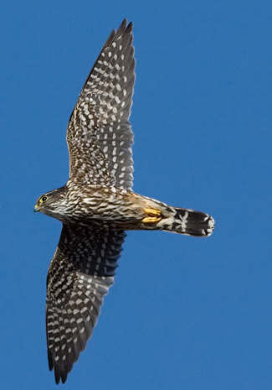
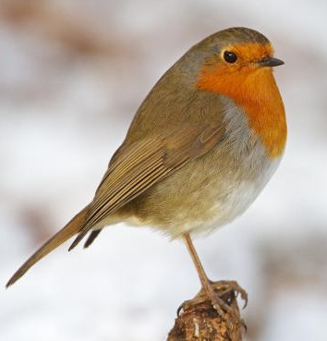
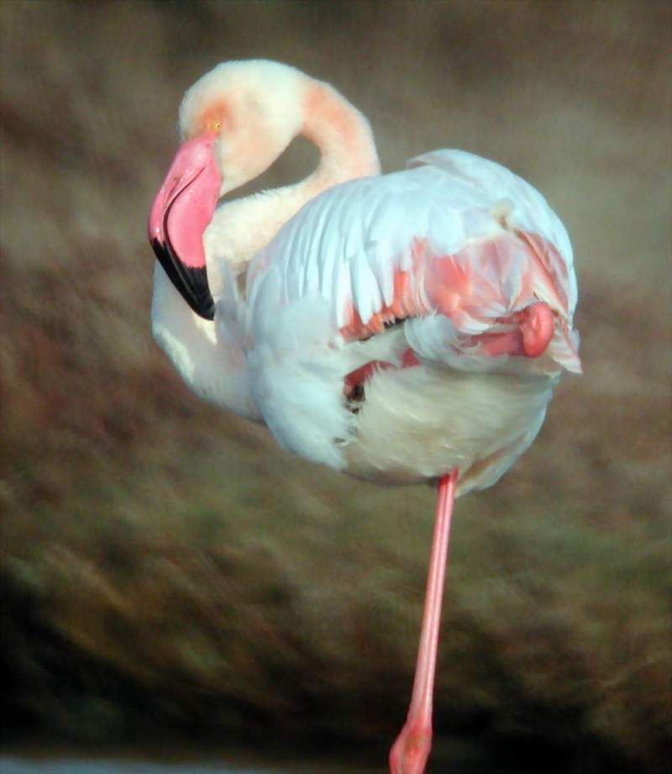
Partial wintering migration
Partially migratory species provide opportunities to understand:
the mechanisms, environmental or ecological factors causing some individuals to migrate
the demographic consequences of different migratory behaviors.
© Charles W Melton
© Volkan Yüksel
Notes:
In many animal populations the seasonal migration between reproductive sites and winter quarters involves only a fraction of the population.
Several, non exclusive hypotheses have been proposed to explain the existence of partial migration.
Partially migratory populations may consist of genetically different sedentary and migratory individuals
Additionally, partial migration may respond to a behavioral or a state-dependent strategy varying. In this case, the migratory behavior is expected to be conditional on trade-offs influenced by environment (i.e., density-dependent processes) and individual competitive abilities (linked to body condition, age or sex) (
Partially migratory species provide opportunities to understand the mechanisms, environmental or ecological factors causing some individuals to migrate when others remain resident year round.
The identification of demographic consequences associated with different wintering or migratory behaviors that have important implications for evolutionary ecology and population dynamics

Slide 8
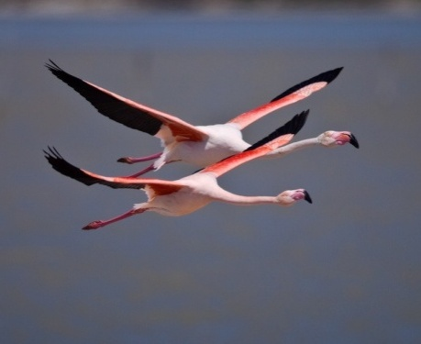
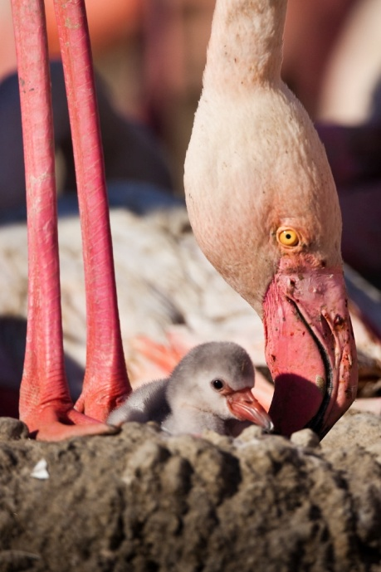
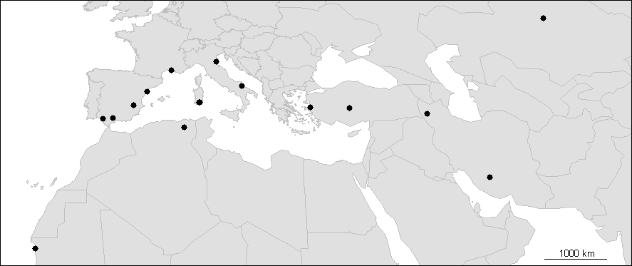
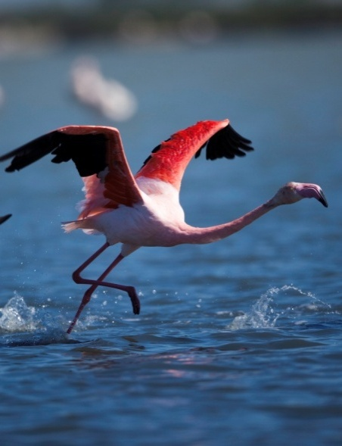
Greater Flamingo (Phoenicopterus ruber roseus)
Long lived waterbird (40 y. wild / > 60 y. captivity)
Inhabits temporary to permanent brackish and wetlands
Partial winter migrant
Dense breeding colonies (undisturbed islands)
Age of maturity= 3y
High fidelity to wintering and breeding areas
© Nicolas Van Ingen
© Nicolas Van Ingen
(Barbraud et al 2003; Amat et al 2005; Balkız et al 2007; Johnson & Cézilly 2007; Balkız et al 2010)
© Nicolas Van Ingen
Notes:
Mediterranean flamingos are partial winter migrants; some individuals remain near their breeding grounds whereas others migrate to close or more distant wintering areas over the western Mediterranean and North Africa
Movement is important in this species so that the breeding colonies of the Mediterranean basin function like a metapopulation sensu lato
In fact, flamingos have extraordinary movement capabilities, adults being capable of flying over 400 kilometers during a single night.
Previous studies have shown a high fidelity to wintering and breeding areas during individual’s life
is a long -lived waterbird (can live up to 40 years old in the wild and > 60 years old in captivity)
inhabiting (both during reproductive and wintering seasons) temporary to permanent brackish or wetlands all over the world where they feed on aquatic invertebrates and seeds
Reproduction depends on the availability of undisturbed islands inside body waters to avoid predation.

Slide 9
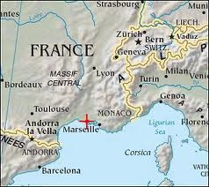
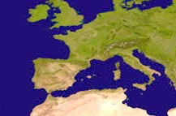
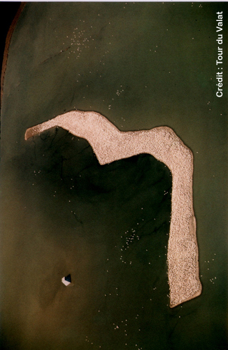
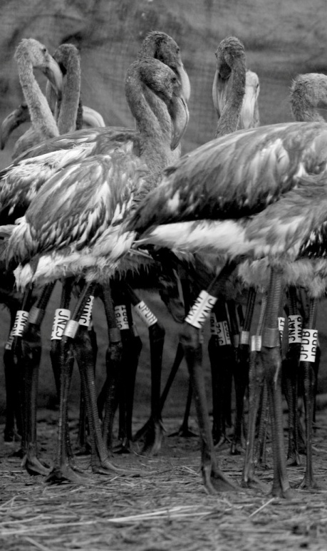
The Camargue colony
Flamingos breed in saline lagoons
Since 1969 annual reproduction at the Fangassier’ pond (artificial island)
Average 10.000 breeding pairs
Since 1977, 7-30% of chicks captured and marked annually
Resighted all around the Mediterranean basin
(Johnson & Cézilly 2007)
© Hervé Hote
Notes:
Flamingos have bred intermittently in the saline lagoons of the Camargue (southern France) for centuries
Since 1969 and the building of an artificial island on the Fangassier’s pond flamingos have bred every year (except 2007) in the Camargue, south of France with an average of 10 000 breeding pairs.
Since 1977, with the exception of 2002 and 2007 , 7–30% of young flamingos (of unknown sex) reared each year in the Camargue have been marked individually with plastic rings engraved with a three or four digit code, which allows individual recognition in the field.
Ring codes can be read using a telescope and from a distance up to 300-400 meters.
These birds have been resighted during the breeding and wintering seasons all around the Mediterranean basin.

Slide 10
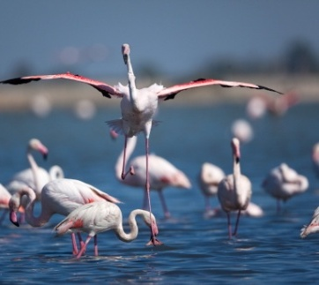
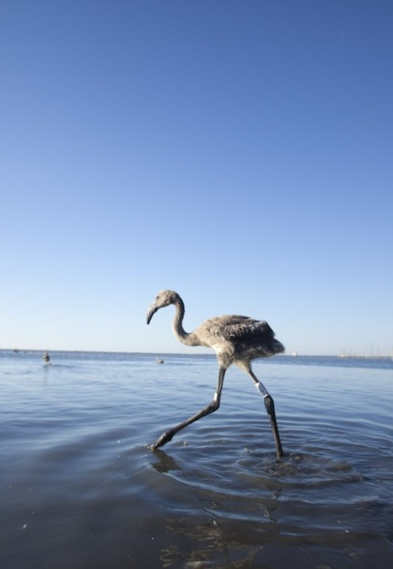

Background
Survival may vary between wintering strategies
Migration is a costly process
Resource availability may be higher at southern latitudes
© Nicolas Van Ingen
(Sillet & Holmes 2002; Alerstam et al 2003)
Objective 1
To study the potential age-related differences in survival probabilities of individuals wintering in different areas:
Resident individuals
Medium- distance wintering migrants
Long-distance wintering migrants
Notes:
Here, using the data on a long-term (35 years) monitoring program of Greater flamingo born in the Camargue (France) and resighted all over the Mediterranean we studied the influence of environmental factors on juvenile migration and the trade-offs resulting of different migratory strategies
Given that wintering migration can be a costly process (Sillet & Holmes, 2002) but also can provide increased resource availability (Alerstam et al., 2003), we expect different survival probabilities for resident individuals, medium- and long-distance migrants.
studied the potential age-related differences in survival probabilities of individuals wintering in different areas (resident individuals, medium- and long-distance wintering migrants).

Slide 11

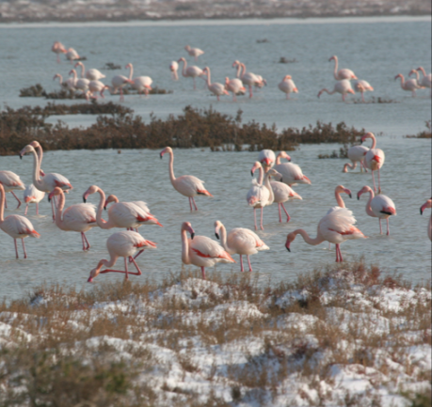
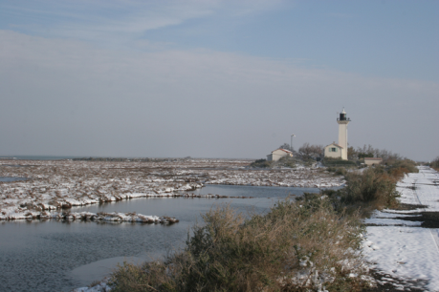
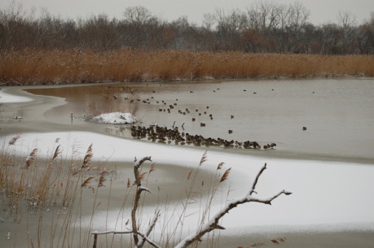
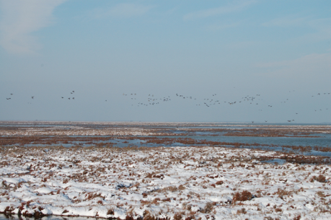
Background
During winter 1984-85, consecutive extremely cold days (-11°C) froze coastal lagoons of Southern France during two weeks
More than 3000 flamingos died
(Lebreton et al 1992; Johnson & Cézilly 2007; Balkız et al 2010)
Objective 2
To estimate the direct impact of the cold spell on resident individuals in terms of age related mortality.
© Reserve Nationale Camargue
Notes:
Consecutive extremely cold days with temperatures that reached -11°C caused the frozen of coastal lagoons during two weeks. It is known that the cold spell caused the death of >3000 flamingos in the Camargue (France) Lebreton et al., (1992), Cézilly et al., (1996) and Balkız et al., (2010) evidenced a reduction in flamingo survival rate during the cold winter in comparison with normal winters. However, these analyses were based on data from individuals resighted during summer at the breeding colony of the Carmargue, and consequently, includes individuals wintering in different winter grounds. It was the only cold spell recorded during the study period.
estimated the direct impact of an exceptional cold spell occurred in southern France during the winter 1984-1985 on resident individuals in terms of age related mortality.

Slide 12
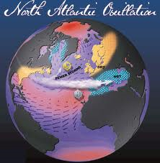
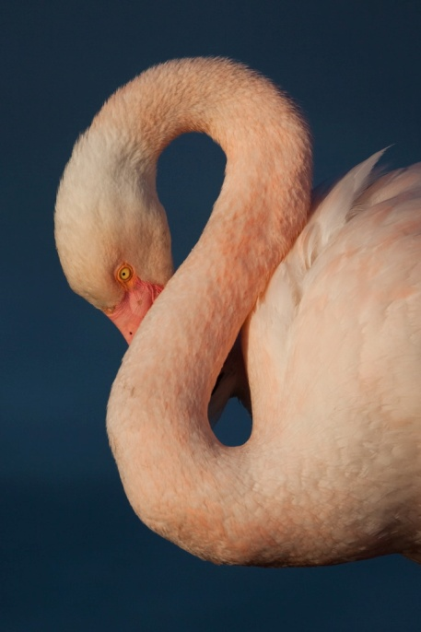

Background
The North Atlantic Oscillation index (NAO) dominates the precipitation variability in the Mediterranean.
Juvenile survival and migration probabilities might decrease during drought years due to reductions in food resources and availability of intermediate stopovers.
(Amat et al. 2005; Nevoux et al. 2008; Grande et al 2009; Sousa et al 2011)
© Nicolas Van Ingen
Objective 3
To test the influence of environmental conditions (winter NAO) on first winter survival and migration probabilities.
© Nicolas Van Ingen
Notes:
The North Atlantic Oscillation index (NAO) dominates the precipitation variability during the wettest months in the Mediterranean. During its negative phase, precipitations increase over the Mediterranean and vice versa .
Studies on other migratory birds have shown variations in survival linked to rainfall levels
We expected lower juvenile survival and migration probabilities during drought years as a response to a potential reduction in food resources and availability of intermediate stopovers, a critical landscape facilitator of long-distance movement in this species.
tested the influence of environmental conditions (NAO index) on first winter survival and migration probabilities.

Slide 13
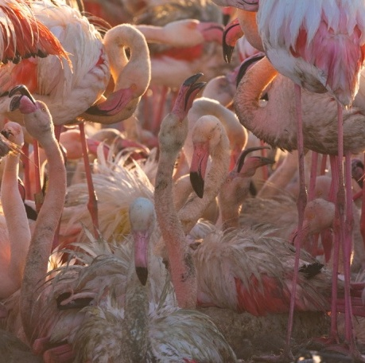
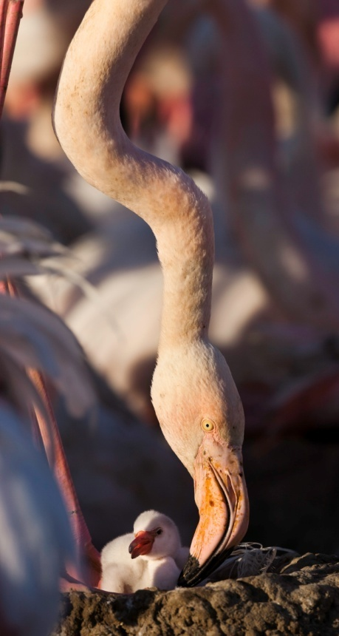
Background
The Camargue colony is a saturated high quality breeding site (annual reproduction).
Early arrival should enhance chances of reproduction.
Mature individuals should show a tendency to winter near the Camargue colony.
(Ketterson & Nolan 1983; Johnson & Cézilly 2007; Balkız et al 2010)
Objective 4
To estimate age-related probabilities of fidelity and dispersal from previous wintering areas.
Notes:
Successful reproduction at the Camargue colony occurs nearly annually since the construction of an artificial island in the Fangassier salt pan, in contrast with other Mediterranean colonies. Given the high quality of this breeding site and the high competition for nesting place observed wintering resident individuals may benefit for early arrival. We expect an increase in fidelity and movement to the Camargue from more distant wintering sites with individual age.
Our objective was to estimate the age-related probabilities of fidelity and dispersal from previous wintering ground.

Slide 14
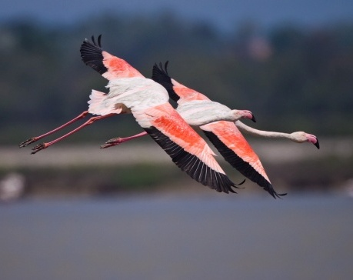
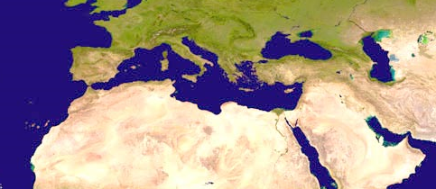
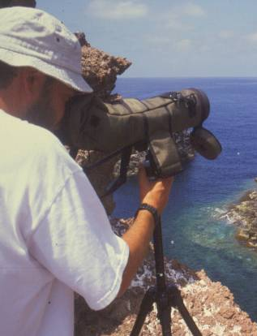
Individual data
Long term study, 1977-2010 (35 years)
22.671 chicks ringed on the Fangassier’s Lagoon (France )
793.485 resights in 4 wintering areas (November-January)
© Hervé Hote
Multisevent Capture-Recapture Modeling
Notes:
We considered observations (capture at fledgling and winter resights) of 22671 birds ringed as chicks on the Fangassier’s lagoon in the Camargue, south of France during the period 1977-2010.
Four wintering areas, considered as the most important wintering siteis for the species n the Mediterranen region, were distinguished Southern France , The Iberian Peninsula, Italy and North Africa.
We model data using multistate capture-recapture models, wich allow to estimate simoultaneuously, survival and movement probabilities in presence of imperfect detection of individuals

Slide 15
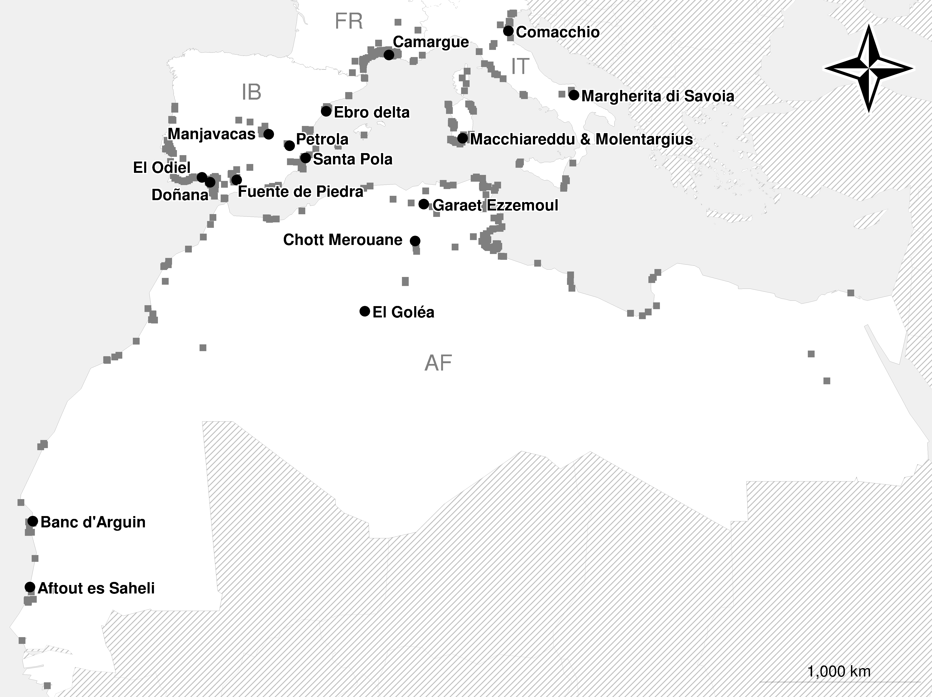
Wintering histories of 22671 flamingos from 1977 to 2010

Slide 16
Multi-site capture-recapture models
permit the estimation of :
migrations across sites
survival according to site
capture rates in each site

Slide 17
Parameters to estimate
at time i survives until time (i+1)
at time i and surviving between times i and i+1 is in site s at time (i+1)
at time i is captured
Note that :
at time i is alive in site s at time (i+1)

Slide 18
Migration parameters
Year
State 1 2 3 4
1 ○ ○ ○ ○
2 ○ ○ ○ ○
3 ○ ○ ○ ○

Slide 19
Migration parameters
Year
State 1 2 3 4
1  ○ ○ 
2 ○  ○ ○
3 ○ ○ ○ ○
?
?
Capture history:
1 2 0 1
?

Slide 20
Maximum likelihood estimation
Probability of observing the capture history (1 2 0 1):
?
Probability of observing the entire data set:

Slide 21
Maximum likelihood estimation
Direct formulas for the Arnason-Schwarz model: (Φ_{t*s} , P_{t*s}, ψ_{t} )
survival/transition and capture probabilities depending on time (and site) only
Numerical iterations in programs MSSURVIV, MSSURGE, MARK

Slide 22
Matrices of parameters
At each time i, we estimate :
a VECTOR of survival parameters :
a VECTOR of capture parameters :

Slide 23
Matrices of parameters
At each time i we estimate :
one matrix of movement parameters :
Note:
row-sums = 1

Slide 24
Which parameters are identifiable?
Since each row-sum of the movement matrix Ψ equals 1, there are S non-identifiable parameters in this matrix :

Slide 25
Which parameters are identifiable ?
Same problem as in one-site C-R models:
with time-dependecy (Φ_{t*s} , P_{t*s}, ψ_{t} ), the last parameters of capture and transition ON EACH SITE are not estimable separately
only the products
,
, and
are separately estimable
(for site 1)
i.e. there is one more non-estimable parameter for each site.

Slide 26
Comparison with one-site capture-recapture models
capture histories with several alive states
(e.g. 1 2 0 1)
Estimation conditional on numbers released
The iii hypothesis must still hold
Not all parameters identifiable (np ≤ n)
Number of occasions K must be >2 to separate survival / transition rates from recapture probability
The “Arnason-Schwarz” model

Slide 27

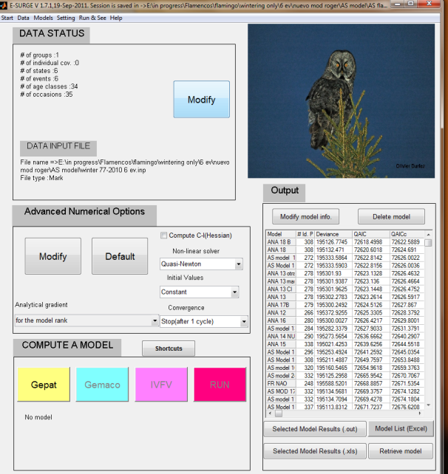
Methods: Multistate CR modelling
1 2 3 … … … … … ….. t
Recapture probability
Ø
Ø
Ø
Survival probability
Transition/Movement probability
FR
FR
SP
SP
Fled
IT
IT
Program E-SURGE
AF
AF
First wintering
migration
Model selection AIC
Fidelity /dispersal
Notes:
We evaluated the influence of age, wintering area and environmental conditions on survival and presence into the different wintering areas probabilities. To do this, observations were written in multistate encounter-histories and analyzed using multistate capture–recapture models (Brownie et al., 1993; Lebreton & Pradel, 2002). These models include three types of parameters, noted and defined as follows:
- p _{rt} : the probability that a marked bird is recaptured at time t in site r, given that it is alive and present in the population at time t.
- Φ _{r t} : the probability that a bird in site r at time t survives until t + 1.
- Ψ_{rs t} : the probability that a bird in site r at time t is in site s at t+1, given that the individual survived from time t to time t + 1.
These parameters were estimated simultaneously from the whole encounter histories by maximum likelihood procedure.
Models were built and fitted to the data using program E-SURGE 1.4.4 (Choquet et al., 2009b). Model selection was based on the Akaike’s Information Criterion adjusted for small sample size (c) and overdispersion (Q)
Based on previous knowledge of the species, we began model selection by a model considering:
Variation in survival probabilities between 4 age classes (Barbraud et al., 2003; Souchay et al., in prep): from fledgling to first winter (a1), first to second winter (a2), second to third winter (a3), and successive winters (a4+).
Variation in survival probabilities between wintering areas following the first arrival to wintering areas (i.e. a2, a3, a4+) (Johnson et al., 1991).
Temporal and spatial variation in the probabilities of dispersal from fledgling to first wintering location (a1) (Nager et al., 1996; Barbraud et al., 2003).
Spatial variation in the probabilities of wintering area dispersal after first winter (Barbraud et al., 2003).
Temporal and spatial variations in resighting probabilities (Barbraud et al., 2003).

Slide 28
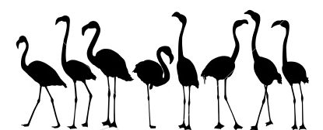





Survival probabilities
↑ age
1st –2nd winter < Africa From 3rd winter > Africa
Cold spell (FR 1984-1985) reduced mean survival by 77%, 55% and 35%
No NAO effect

Slide 29
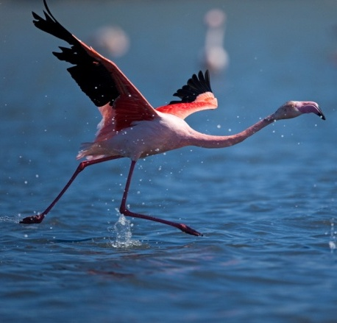
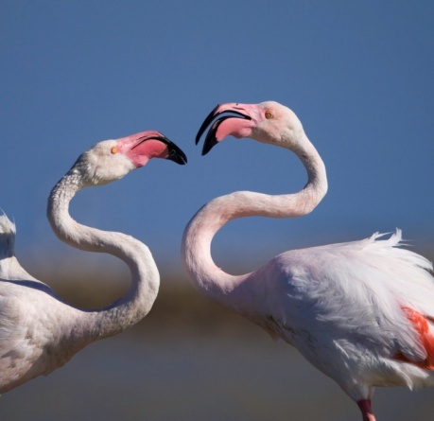
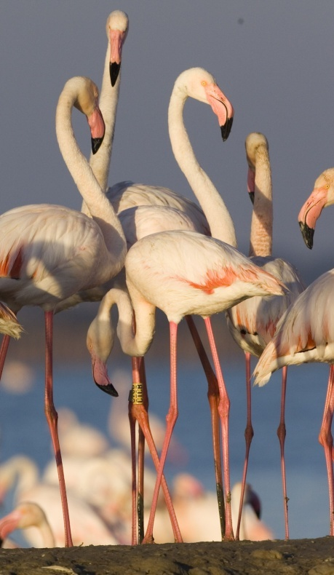
Survival probabilities: age/spatial variation
Long distance migration may be more costly for individuals in worse condition and inexperienced individuals
After their second winter, survival probabilities of individuals wintering in African sites were higher, probably due to better local conditions.
© Nicolas Van Ingen
© Nicolas Van Ingen
(Ketterson & Nolan 1982; Alerstam et al 2003; Barbraud et al 2003)
Notes:
We found that young individuals wintering in African sites presented lower survival probabilities that those wintering in Spanish, Italian or French sites, suggesting that long distance migration may be associated with a certain energetic cost and may only be performed successfully by individuals in better condition (Alerstam et al., 2003).
In contrast with the patterns of survival found for young birds, after their second winter, survival probabilities of individuals wintering in African sites were higher that individuals wintering in the northern rim of the Mediterranean. Two possible and non exclusive hypotheses may explain this result. First, better local conditions in southern areas may increase survival chances of wintering individuals
Second, the survival cost paid early at life by individuals wintering in Africa linked to the observed high fidelity to wintering areas may promote the existence higher numbers of high quality individuals with higher survival chances among those wintering in African sites.

Slide 30
First wintering area
Winter NAO explained 12% of the temporal variability (F_{1,31}=3.96 p=0.055)
Cohort
Notes:
There was a substantial temporal variation in first wintering area selection after fledgling .The winter NAO covariate explained a 12% of the temporal variability of migration probabilities of fledglings, being this effect statistically significant .
During the study period, mean probabilities of spending first winter in French, Spanish, Italian and African sites were 18%, 29%, 18% and 34%, respectively (model 7, Table 1).

Slide 31
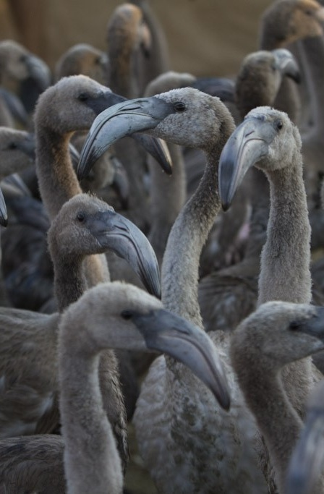
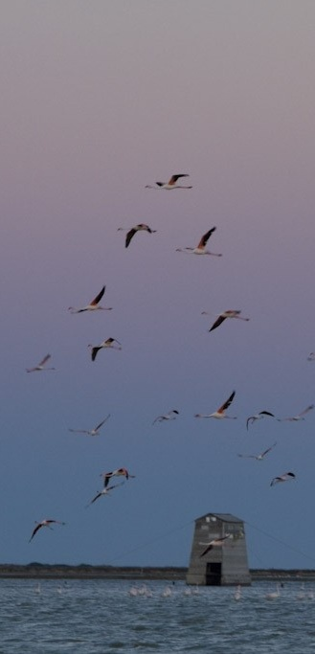
First migration determinants
Annual variability in first wintering migration probabilities in the greater flamingo was negatively correlated with the winter NAO.
Higher levels of migration from the natal area were estimated in wet years
The higher availability of intermediate stopovers during wet years may facilitate long-distance migration in this species
© Hervé Hote
(Barbraud et al 2003; Amat et al 2005)
Notes:
annual variability in first wintering migration probabilities in the greater flamingo was negatively correlated with the winter North Atlantic Oscillation index.
Given that winter NAO index impact on Mediterranean droughts ,higher levels of migration from the natal area were estimated in wet years.
During droughts, temporary Mediterranean wetlands are commonly dry. The higher availability of intermediate stopovers during wet years may facilitate long-distance migration in this species ,especially for individuals in poorer body condition .

Slide 32

Fidelity to wintering areas
High fidelity to previous wintering area
In general increases with individual age
Notes:
Fidelity to wintering areas was very high, increasing with individual age (with the exception of birds wintering in Africa that shown similar fidelity whereas their age)

Slide 33

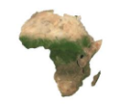





Dispersal from previous wintering areas
From their second winter on, unfaithful individuals that previously used Spanish, Italian or African wintering areas dispersed preferably to French wintering sites
Average breeding success is higher in the Camargue colony than in other Mediterranean colonies. Individuals probably tend to winter near this colony when they become mature in order to arrive early
(Kokko 1999)
Notes:
No substantial differences between future winter location of individuals leaving their first or second wintering areas were detected.
From their third winter, unfaithful individuals that previously used Spanish, Italian or African wintering areas wintered preferably in French sites

Slide 34
Population consequences of different migratory behaviors
Notes:
Survival rates of long-distance wintering individuals and short to medium distance wintering individuals showed marked differences, being higher early at life for individuals wintering close to their natal area but lower from their third winter. Unfortunately, the lack of data on breeding success for both types of individuals prevents to perform accurate population models able to predict the fitness consequences of the observed wintering behaviors (Caswell, 2001). By considering that both types of individuals may have a similar breeding success or being lower for long distance wintering individuals due to a potential later arrival to high quality breeding colonies (Ketterson & Nolan, 1983; Kokko, 1999), the African wintering strategy will be generally worst (Appendix 2, Figure 6). Only by supposing an expected breeding success lower than 0.2 the long-distance wintering strategy will be better, but the expected population growth rates will be negative (Appendix 2, Figure 6). Given the mean breeding success estimated at the Camargue colony (0.46; Béchet & Johnson, 2008) and the survival rates estimated for long-, medium-, and short- distance wintering individuals, the expected population growth rates estimated will be positive (Figure 6, Appendix 2,). In fact, population numbers of Greater flamingo at the western Mediterranean have greatly increased during the last decades (Johnson & Cézilly, 2007). Although the expected fitness of African wintering individuals might be lower, populations composed of individuals behaving differently might have higher probabilities of success under changeable environments that those formed by more homogeneous individuals (Sol et al., 2010). For example, those individuals wintering in southern areas were not affected by the cold spell. Several cold spells occurred in southern France during the last centuries (Johnson & Cézilly, 2007) Arnaud, si tu as la reference pour les populations de l’afrique que sont en train de diminuir on pourrait la mettre ici.

Slide 35
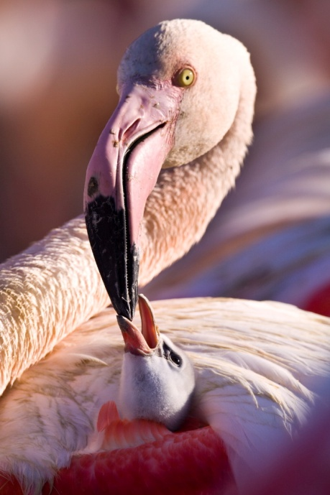
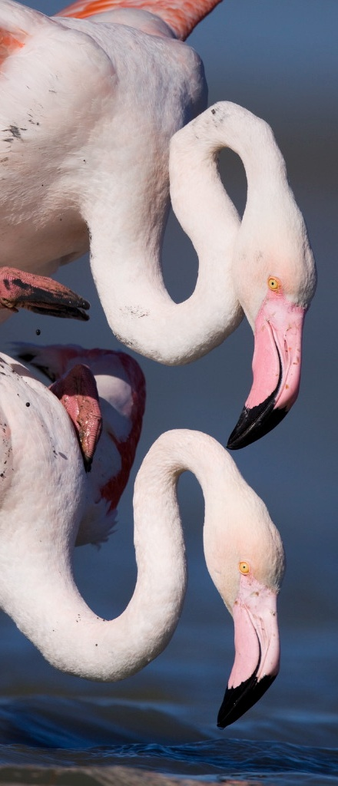
Main conclusions
Long-distance migration is costly for young individuals
Droughts may limit the availability of stopovers and increase residency after fledgling
High fidelity to previous wintering sites and specially to those located near the natal colony.
Individuals tend to winter near their natal colony when they become mature
Global change may challenge the future of Mediterranean flamingo metapopulation in several ways. However, the variability of wintering behaviour already present in the population gives hope that it has the potential to adapt. All strategies observed may be balanced in terms of fitness.
© Nicolas Van Ingen
© Nicolas Van Ingen
Notes:
Fidelity to natal, breeding, or wintering sites is a common phenomenon among many bird species.
Breeding philopatry to natal colonies is very high in the western Mediterranean flamingo metapopulation (>84%), and breeding fidelity also increases with individual breeding experience in the largest colonies .
Similarly, we found a very high individual fidelity to the wintering areas used during their first winter.
Additionally, we found that sexually mature individuals (aged more than 3y) changing their previous wintering area went preferably to French wintering sites. Breeding success (weighted by the frequency of colony availability) in Camargue, is higher than in the other important Mediterranean colonies.
Consequently, competition for nesting sites at Camargue is very intense.
Individuals wintering in French sites may benefit for arriving early, acquiring high quality mate, establishing a nest into the colony and having a potentially higher reproductive success than do those arriving later from more distant wintering areas.
In fact, fidelity to French wintering areas for sexually mature individuals was extremely high (94%).

Slide 36


Slide 37
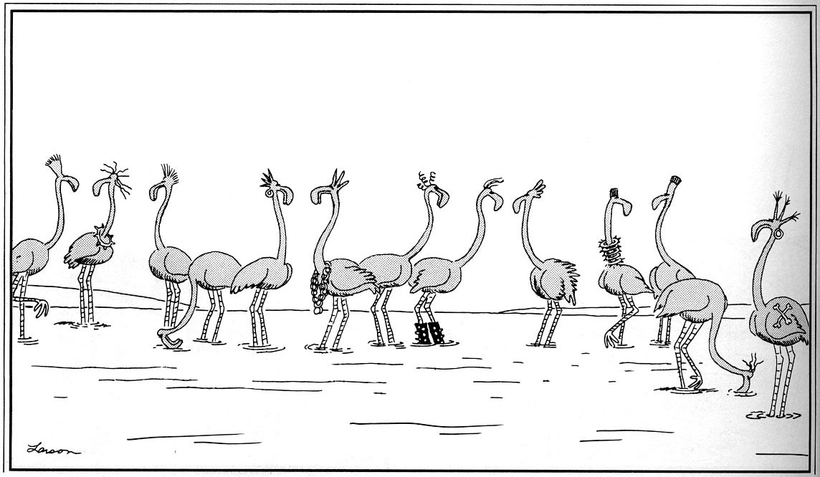

Aknowledgements
MATERGLOBE
Thanks!
¡Gracias!
Merci!
Notes:
Marie Curie Fellowship (Ref. MATERGLOBE). Remi Choquet, Olivier Gimenez

Slide 38
Fig. 1. Greater flamingo breeding colonies occupied at least once between 1983 and 2002 in the Mediterranean. Enlarged are the locations of
the three main colonies of the Western Mediterranean, namely the Camargue (France), Fuente de Piedra (Spain) andMolentargius (Sardinia)
considered in the study.

Slide 39
Description du mouvement
McClintock et al. 2012
Temps court (pas de mortalité) ex. 1 point chaque 2h pendant 5 mois
Transitions entre états comportementaux, z
Description mouvement par distance, s, et direction, φ

Slide 40

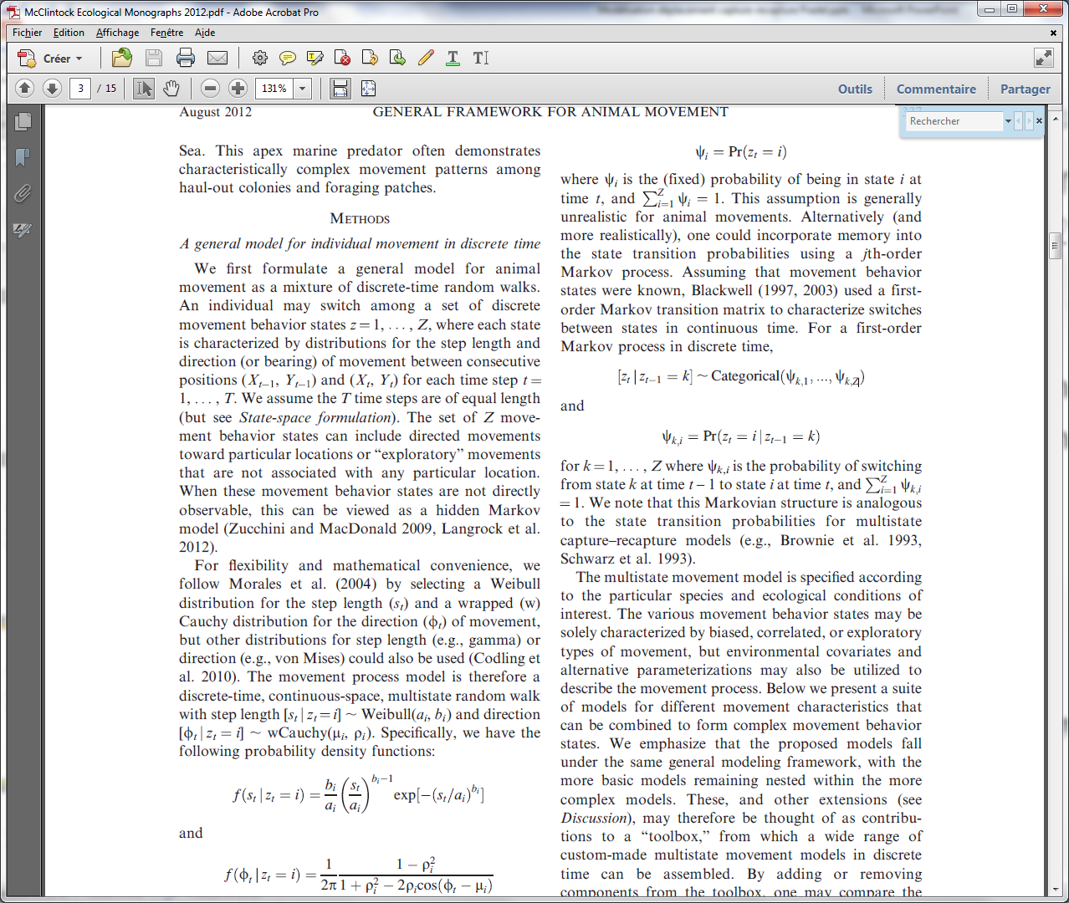
Description du mouvement
McClintock et al. 2012
Behavioral states: directed (e.g. migration), exploratory (e.g. dispersal), area-restricted (e.g. foraging)
Biased and correlated random walk
Estimation by MCMC

Slide 41
Test de mémoire
Pradel et al. 2003
Une étude classique
Principe du modèle de description du mouvement de Morales et McClintock
Le test de mémoire
Une étude atypique: domaine d’activité linéaire (poisson en rivière, Danancher et al. 2004)
Le mouvement à travers des états comportementaux (Avril 2012)

Slide 42
Memory and TEST WBWA
(Pradel et al. 2003)
Next seen
on site
Where After
Where Before
Test
1
2 . . .
Election of a familiar site
Election of a familiar site
Election of a familiar site
+
+
+
1
Last seen
on site
+
+
+
2
. . .

Slide 43
Results of TEST WBWA for the Canada goose data
occ site
2 1
2 2
2 3
3 1
3 2
3 3
4 1
4 2
4 3
5 1
5 2
5 3
sta pval df
19.59 0.000 2
37.87 0.000 2
4.49 0.034 1
80.59 0.000 1
98.76 0.000 4
0.81 0.369 1
27.71 0.000 1
53.69 0.000 2
25.29 0.000 1
43.66 0.000 1
50.93 0.000 2
29.48 0.000 2
-- Test WBWA -----
472.86 0.000 20
^
c = 23.6!

Slide 44
Plan exposé
Une étude classique
Principe du modèle de description du mouvement de Morales et McClintock
Le test de mémoire
Une étude atypique: domaine d’activité linéaire (poisson en rivière, Danancher et al. 2004)
Le mouvement à travers des états comportementaux (Avril 2012)

Slide 45
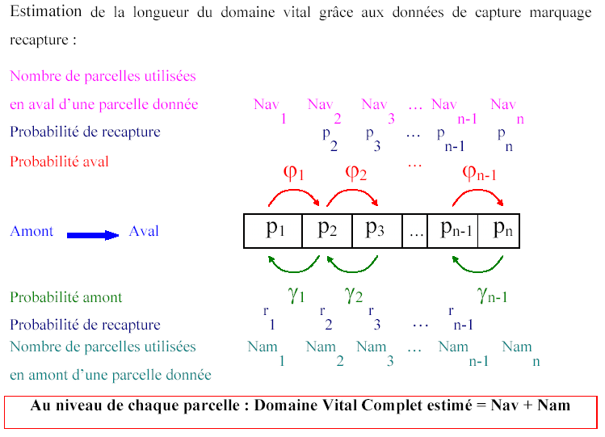
3. Linear home range

Slide 46
Estimation of linear home range
Application to Zingel asper

Slide 47
Collecte des données
Profond
Plat
Radier
340 m
25 à 40 m
Notes:
Rivière Beaume, affluent de l’Ardèche (aval de Rosière)
Habitat profond -> courant faible -> limitation de la dépense énergétique
Radier favorable à la reproduction (oxygénation, percolation à travers galets, pas d’envasement)
mais courant fort -> importantes dépenses énergétique.
Courant croissant de profond à radier en passant par plat

Slide 48
Collecte des données
Sessions de recapture :
- Période de reproduction :
Mars 2000
- Période de croissance
Mai-juin 2001
Trois groupes d’individus :
- Les femelles en période de reproduction
- Les mâles en période de reproduction
- Les individus en période de croissance

Slide 49
Constitution des histoires de capture
Histoires de capture
1
1
0
1
…
0
0
0
0
+

Slide 50
Travail de modélisation
La taille du domaine vital dépend :
        Du sexe des individus
        De la période du cycle vital
        De l’habitat considéré.

Slide 51
MALES EN PERIODE DE REPRODUCTION
Profond
Plat amont
Plat aval
Radier

Slide 52
Longueur moyenne du domaine vital

Slide 53
Différences concernant le type d’habitat utilisé.
Mâles en période de
reproduction
Femelles en période de
reproduction
Individus en période
de croissance

Slide 54
Plan exposé
Une étude classique
Principe du modèle de description du mouvement de Morales et McClintock
Le test de mémoire
Une étude atypique: domaine d’activité linéaire (poisson en rivière, Danancher et al. 2004)
Le mouvement à travers des états comportementaux (Avril 2012)

Slide 55
Lièvres suivis par télémétrie
triangulation
Une fois par semaine à proximité du lieu de capture initial
Mouvements habituels <600m
Excursions occasionnelles >1000m sans dispersion
Dispersion >600m avec phase de transience durant jusqu’à 2 mois
Chasse fin septembre-fin décembre

Slide 56
Lièvres suivis par télémétrie
25 sessions de 2 semaines séparées par 2 sem.
78 juv males, 71 juv femelles, 3 males adultes

Slide 57
B
C
A
1000 m
Figure 1: Examples of dispersal movements in hares in three behavioral groups: (a) philopatric “explorer” pattern, (b) “shifter” disperser, (c) “one-way” disperser. The large circle represents a circle 588 m in radius, the center of which was used as the estimated birth site (triangle).

Slide 58
Table 1. States, numerical code used in encounter histories, events, and detection probabilities used in the model. The states ND^{TD} and ND^{H} are observable but bear uncertainty concerning the state (T or D) and the distance respectively, in which the hare is at a particular occasion. All other observable states are known with certainty at the time of capture. Temporary undetectable states and states related to individuals with a radio-collar out of order are not at risk of capture and so unobservable (p=0).
“State”/ nominal labelling | Corresponding event at occasion t | Numerical labelling | Capture
1) Observable states
“Stationary”/S | “seen alive <1000m” | 1 | p₁
“Transient” /T - conditional on being S at occasion t-1 | “seen alive >1000m” | 2 | p₂
“Disperser” /D - conditional on being T at occasion t-1 | “seen alive >1000m” | 2 | p₂
“Newly dead stationary” /ND^{S} | “recovered dead <1000m from causes other than hunting” | 3 | p₁
“Newly dead transient or disperser” /ND^{TD} | “recovered dead >1000m from causes other than hunting” | 4 | p₂
“Newly dead hunting” /ND^{H} | “recovered shot < or >1000m” | 5 | 1
“Nearly lost stationary” /Nl^{S} | “seen alive <1000m with a waning radio signal” | 6 | p₁
“Nearly lost transient” /Nl^{T} | “seen alive >1000m with a waning radio signal” | 7 | p₂
“Nearly lost disperser” /Nl^{D} | “seen alive >1000m with a waning radio signal” | 7 | p₂
2) Non-observable states
“Transient temporary undetectable” /T^{u}- conditional on being S at occasion t-1 | “not seen” | 0 | 0
“Disperser temporary undetectable” /D^{u}- conditional on being T^{u} at occasion t-1 | _ | _ | _
“Lost Stationary” /L^{S} | _ | _ | _
“Lost transient” /L^{T} | _ | _ | _
“Lost diperser” /L^{D} | _ | _ | _
“Newly dead lost from causes other than hunting” / ND^{L} | _ | _ | _
“Dead since more than one capture occasion” /† | _ | _ | _

Slide 60
The multievent model
Pradel 2005
b, probabilities of events conditional on current state
E₁
E₂
E₃
events
S₁
S₂
S₃
states
π, initial state probabilities
φ probabilities of transition
Note: it belongs to the class of Hidden Markov Models
Notes:
A typical sequence in a capture history would be…. The truth is

Slide 61
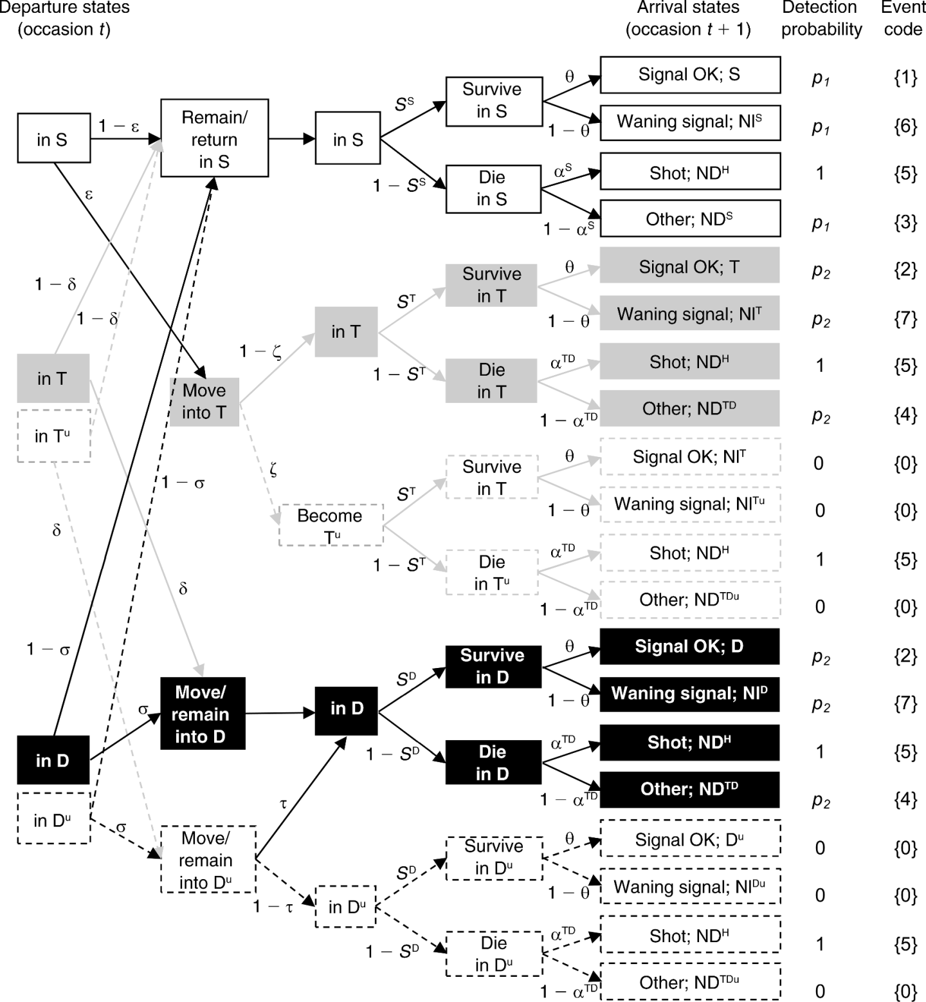

Slide 62
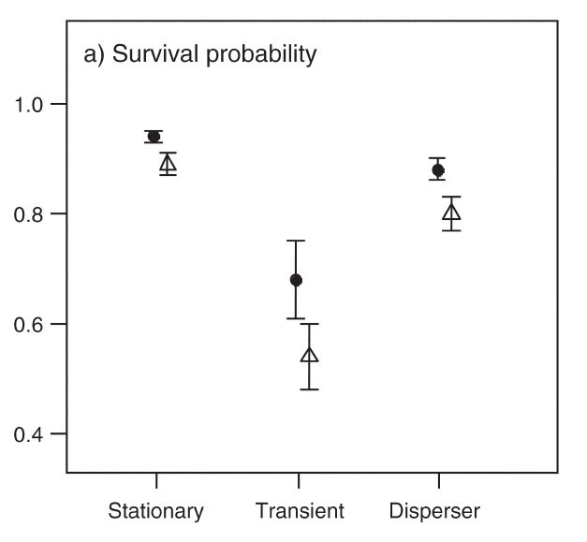

Slide 63
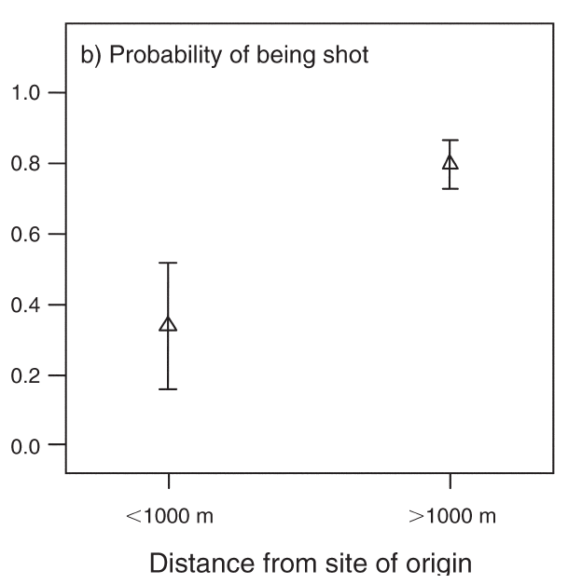

Slide 64
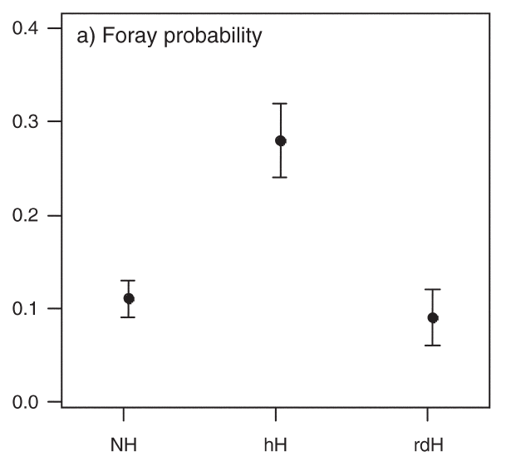

Slide 65
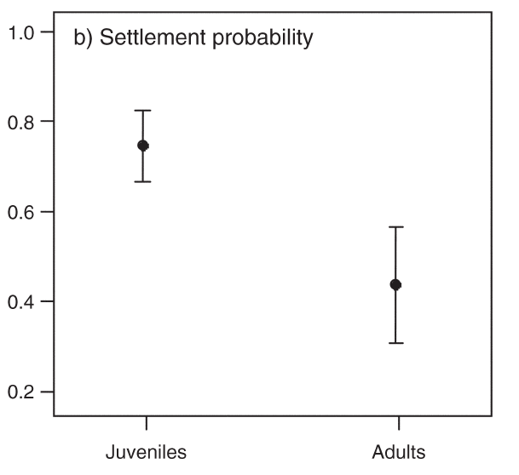

Slide 66
Conclusions
Du maximum de vraisemblance au MCMC
Stratégie vs tactique
Mémoire ou tempérament

