Slide 1
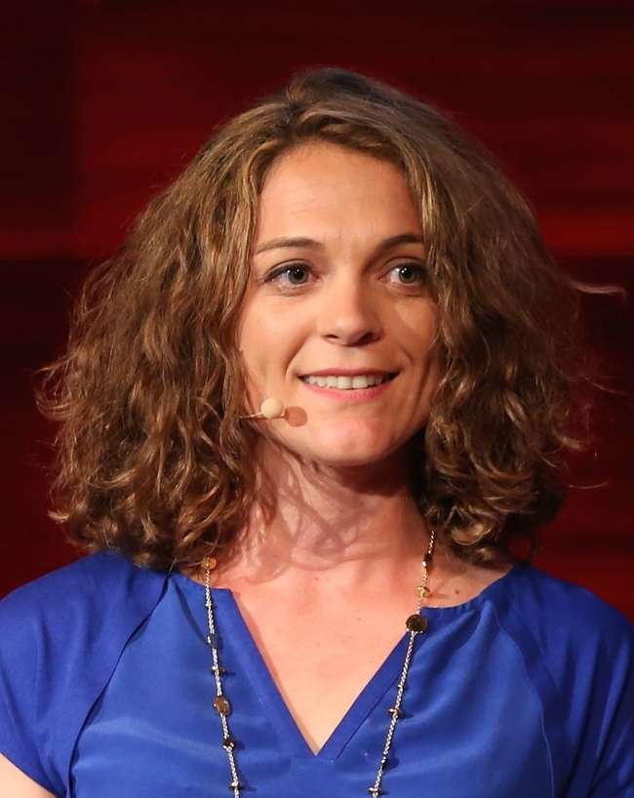
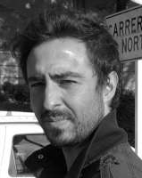

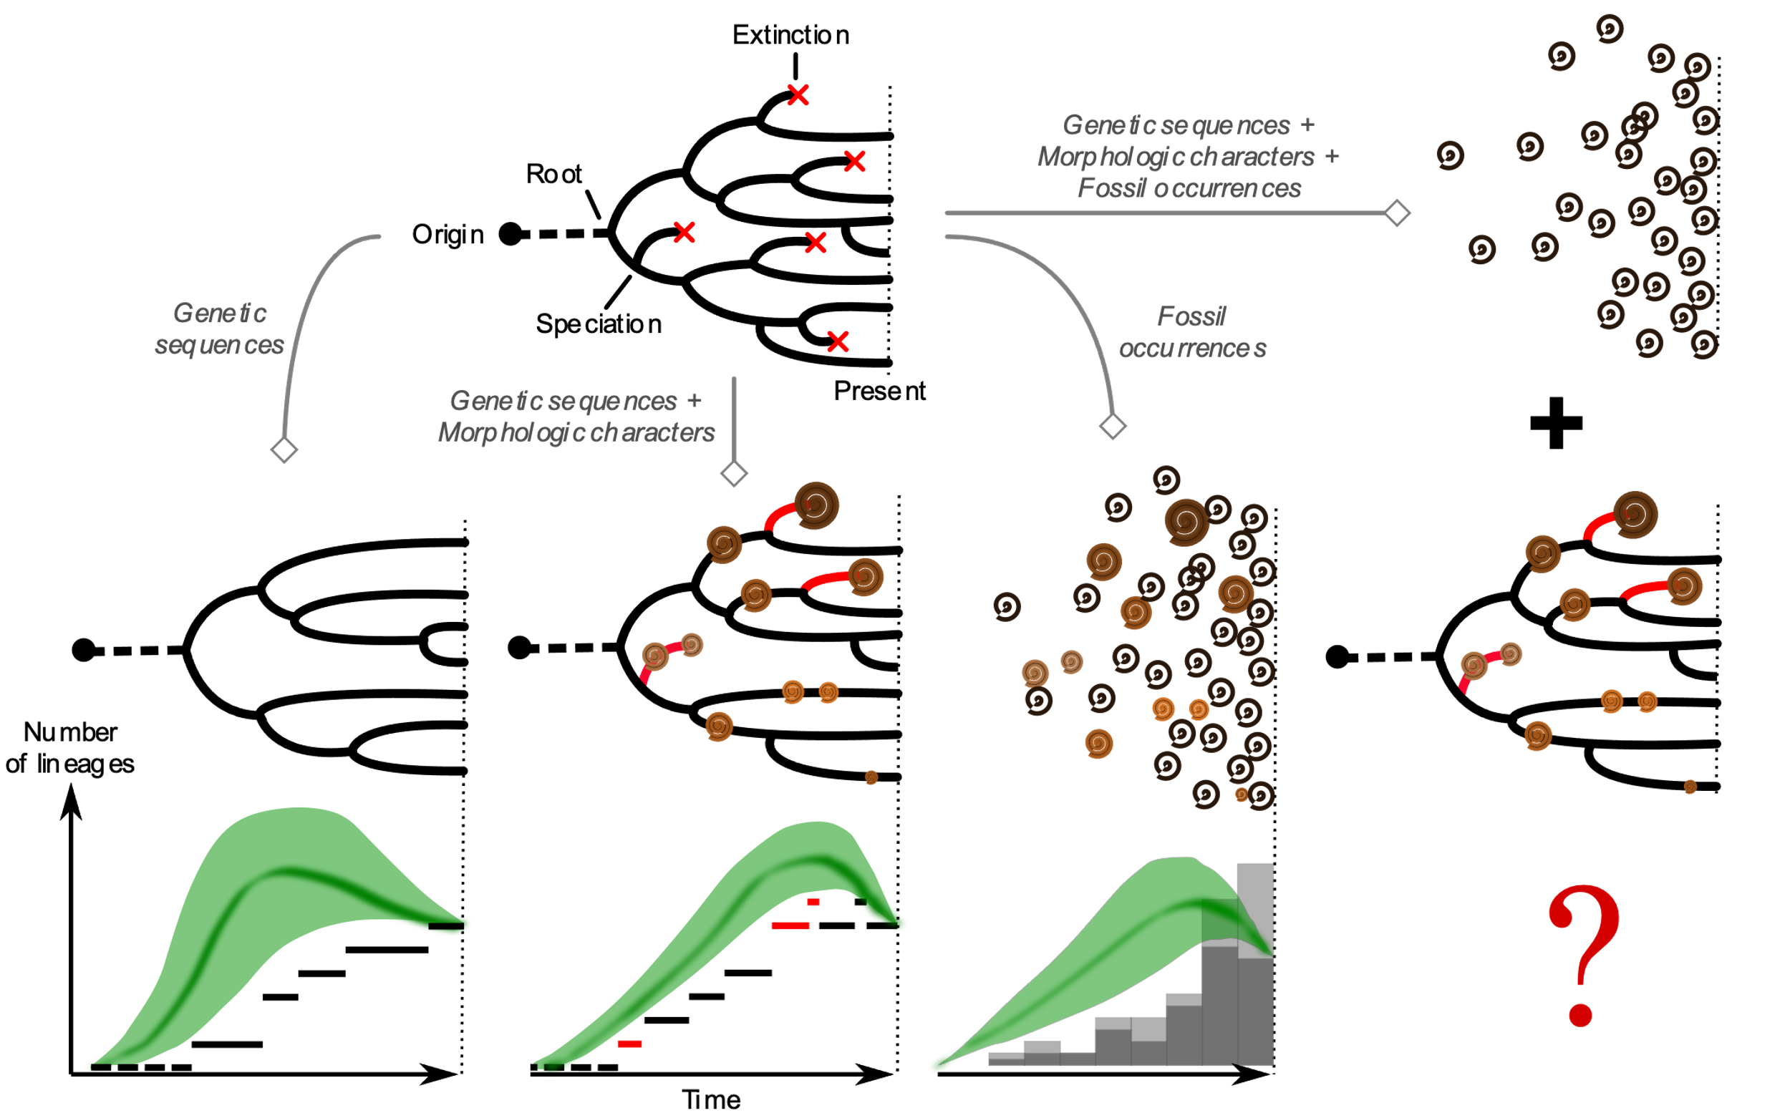
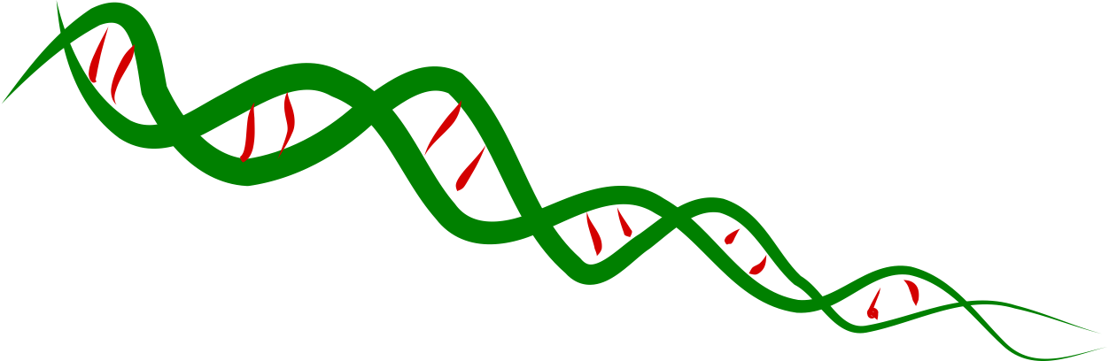
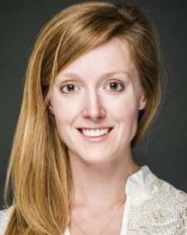
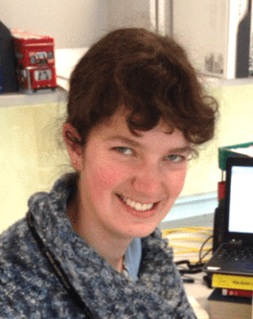

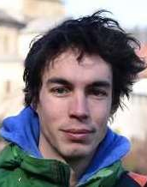
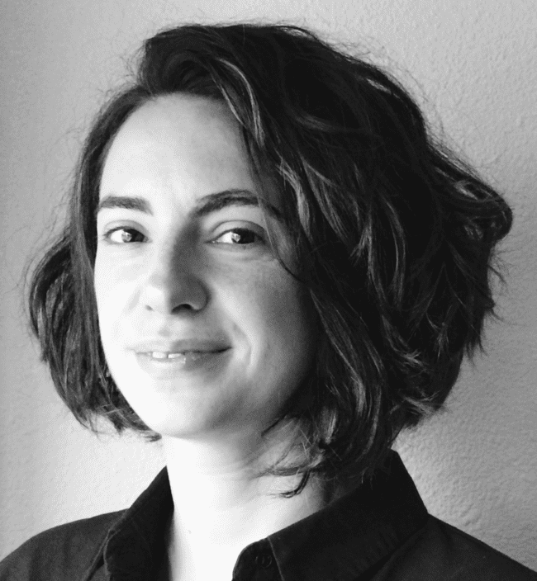
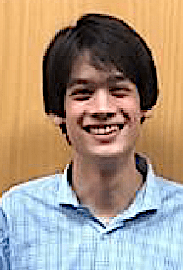

Intégration des fossiles dans les modèles de naissance-mort
Comparaison des méthodes d’inférence
Jérémy Andréoletti – Hélène Morlon, Ignacio Quintero – Erin Saupe, Isabel Fenton – Marc Manceau , Rachel Warnock, Antoine Zwaans

Slide 2
Contexte – Le processus de diversification

Slide 3
Contexte

Slide 4
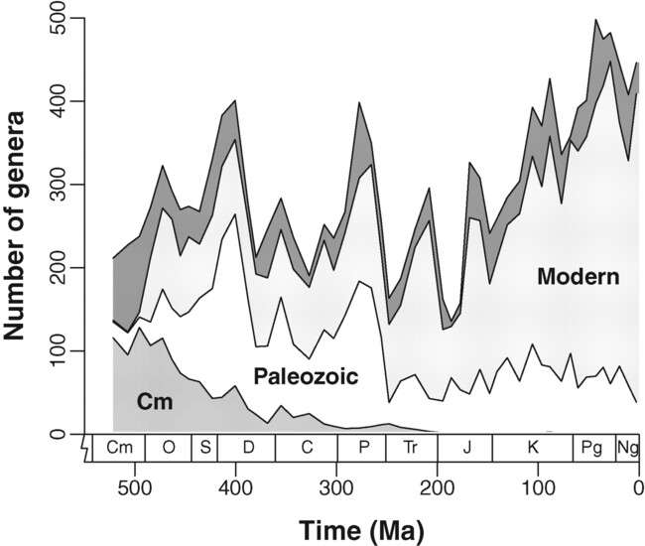
Contexte
Sampling-standardized Phanerozoic marine diversity curves
J. Alroy. The Shifting Balance of Diversity Among Major Marine Animal Groups. Science (2010)

Slide 5
Contexte

Slide 6
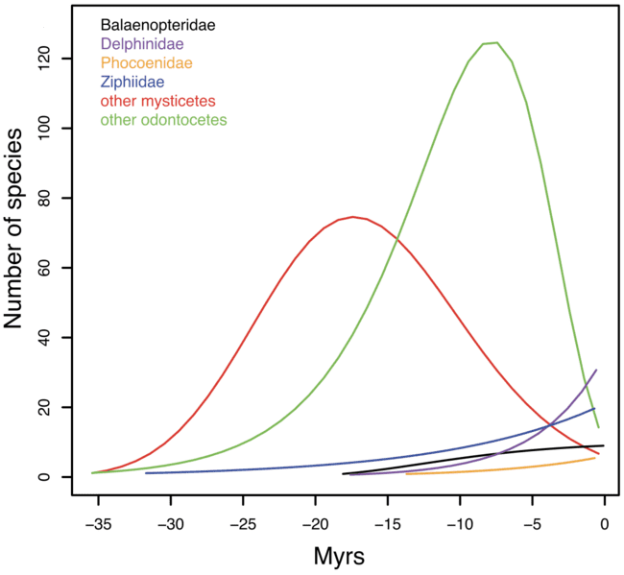
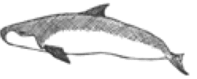

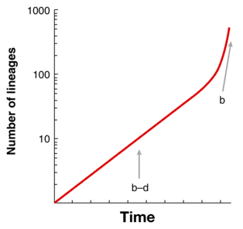




Contexte
Clade-specific diversification of cetaceans
Nee, S., May, R. M., & Harvey. P.H. (1994). The reconstructed evolutionary process. PTRSB
H. Morlon, T. L. Parsons, and J. B. Plotkin, Reconciling molecular phylogenies with the fossil record. PNAS 1–4 (2011)

Slide 7
Contexte

Slide 8
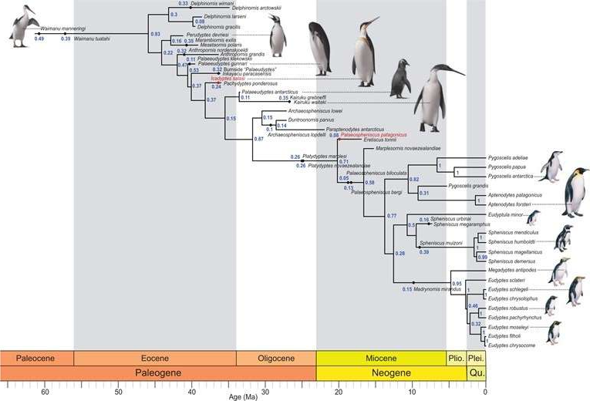
Contexte
Total-evidence phylogeny of penguins
A. Gavryushkina, T. A. Heath, D. T. Ksepka, T. Stadler, D. Welch, A. J. Drummond, Bayesian Total-Evidence Dating Reveals the Recent Crown Radiation of Penguins. Systematic Biology (2017)

Slide 9
Contexte

Slide 10
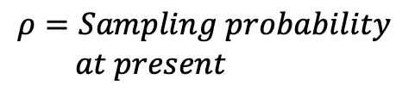






Modèles
The Fossilized Birth-Death Process
⇢ Parameters :
$$t_{or}=Time of origin$$
$$λ=Speciation rate$$
$$ℒ\left(𝒯\right)=ℙ\left(𝒯 | t_{or},λ, μ, ψ, ρ\right)$$
$$μ=Extinction rate$$
$$ψ=Fossil sampling rate$$
$$ρ=Sampling probability \\ at present$$
⇢ Objects :
Model description :
Stadler Journal of Theoretical Biology (2010)
First implementations :
Heath, Huelsenbeck & Stadler PNAS (2014)
Gavryushkina, Welch, Stadler & Drummond PLOS Computational Biology (2014)
$$𝒯=Tree$$

Slide 11






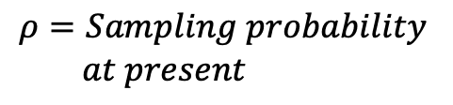


Modèles
The Occurrence Birth-Death Process
⇢ Parameters :
$$t_{or}=Time of origin$$
$$λ=Speciation rate$$
$$ℒ\left(𝒯,𝒪\right)=ℙ\left(𝒯,𝒪 | t_{or},λ, μ, ψ, ω, ρ\right)$$
$$μ=Extinction rate$$
$$ψ=Fossil sampling rate$$
$$ω=Occurrence sampling rate$$
$$ρ=Sampling probability \\ at present$$
⇢ Objects :
Model description + Particle-filtering algorithm :
Vaughan et al. Mol Biol Evol (2019)
New faster algorithm:
Gupta, Manceau, Vaughan, Khammash & Stadler Journal of Theoretical Biology (2020)
Manceau, Gupta, Vaughan & Stadler Journal of Theoretical Biology (2020)
$$𝒯=Tree$$
$$𝒪=Occurrences$$

Slide 12


Modèles
Full process with sampling
True diversity
The Occurrence Birth-Death Process
⇢ Parameters :
$$t_{or}=Time of origin$$
$$λ=Speciation rate$$
$$μ=Extinction rate$$
$$ψ=Fossil sampling rate$$
$$ω=Occurrence sampling rate$$
$$ρ=Sampling probability \\ at present$$
⇢ Objects :
$$𝒯=Tree$$
$$𝒪=Occurrences$$

Slide 13
Modèles
Full process with sampling
True diversity
The Occurrence Birth-Death Process
⇢ Parameters :
$$t_{or}=Time of origin$$
$$λ=Speciation rate$$
$$μ=Extinction rate$$
$$ψ=Fossil sampling rate$$
$$ω=Occurrence sampling rate$$
$$ρ=Sampling probability \\ at present$$
⇢ Objects :
$$𝒯=Tree$$
$$𝒪=Occurrences$$

Slide 14
Modèles
Full process with sampling
True diversity
The Occurrence Birth-Death Process
⇢ Parameters :
$$t_{or}=Time of origin$$
$$λ=Speciation rate$$
$$μ=Extinction rate$$
$$ψ=Fossil sampling rate$$
$$ω=Occurrence sampling rate$$
$$ρ=Sampling probability \\ at present$$
⇢ Objects :
$$𝒯=Tree$$
$$𝒪=Occurrences$$

Slide 15
Modèles
Full process with sampling
True diversity
The Occurrence Birth-Death Process
⇢ Parameters :
$$t_{or}=Time of origin$$
$$λ=Speciation rate$$
$$μ=Extinction rate$$
$$ψ=Fossil sampling rate$$
$$ω=Occurrence sampling rate$$
$$ρ=Sampling probability \\ at present$$
⇢ Objects :
$$𝒯=Tree$$
$$𝒪=Occurrences$$

Slide 16
Modèles
Full process with sampling
True diversity
The Occurrence Birth-Death Process
⇢ Parameters :
$$t_{or}=Time of origin$$
$$λ=Speciation rate$$
$$μ=Extinction rate$$
$$ψ=Fossil sampling rate$$
$$ω=Occurrence sampling rate$$
$$ρ=Sampling probability \\ at present$$
⇢ Objects :
$$𝒯=Tree$$
$$𝒪=Occurrences$$

Slide 17
Modèles
Full process with sampling
True diversity
The Occurrence Birth-Death Process
⇢ Parameters :
$$t_{or}=Time of origin$$
$$λ=Speciation rate$$
$$μ=Extinction rate$$
$$ψ=Fossil sampling rate$$
$$ω=Occurrence sampling rate$$
$$ρ=Sampling probability \\ at present$$
⇢ Objects :
$$𝒯=Tree$$
$$𝒪=Occurrences$$

Slide 18
Modèles
Full process with sampling
True diversity
The Occurrence Birth-Death Process
⇢ Parameters :
$$t_{or}=Time of origin$$
$$λ=Speciation rate$$
$$μ=Extinction rate$$
$$ψ=Fossil sampling rate$$
$$ω=Occurrence sampling rate$$
$$ρ=Sampling probability \\ at present$$
⇢ Objects :
$$𝒯=Tree$$
$$𝒪=Occurrences$$

Slide 19
Modèles
Full process with sampling
True diversity
The Occurrence Birth-Death Process
⇢ Parameters :
$$t_{or}=Time of origin$$
$$λ=Speciation rate$$
$$μ=Extinction rate$$
$$ψ=Fossil sampling rate$$
$$ω=Occurrence sampling rate$$
$$ρ=Sampling probability \\ at present$$
⇢ Objects :
$$𝒯=Tree$$
$$𝒪=Occurrences$$

Slide 20
Modèles
Full process with sampling
True diversity
The Occurrence Birth-Death Process
⇢ Parameters :
$$t_{or}=Time of origin$$
$$λ=Speciation rate$$
$$μ=Extinction rate$$
$$ψ=Fossil sampling rate$$
$$ω=Occurrence sampling rate$$
$$ρ=Sampling probability \\ at present$$
⇢ Objects :
$$𝒯=Tree$$
$$𝒪=Occurrences$$

Slide 21
Modèles
Full process with sampling
True diversity
The Occurrence Birth-Death Process
⇢ Parameters :
$$t_{or}=Time of origin$$
$$λ=Speciation rate$$
$$μ=Extinction rate$$
$$ψ=Fossil sampling rate$$
$$ω=Occurrence sampling rate$$
$$ρ=Sampling probability \\ at present$$
⇢ Objects :
$$𝒯=Tree$$
$$𝒪=Occurrences$$

Slide 22
Modèles
Full process with sampling
True diversity
The Occurrence Birth-Death Process
⇢ Parameters :
$$t_{or}=Time of origin$$
$$λ=Speciation rate$$
$$μ=Extinction rate$$
$$ψ=Fossil sampling rate$$
$$ω=Occurrence sampling rate$$
$$ρ=Sampling probability \\ at present$$
⇢ Objects :
$$𝒯=Tree$$
$$𝒪=Occurrences$$

Slide 23
Modèles
Full process with sampling
True diversity
The Occurrence Birth-Death Process
⇢ Parameters :
$$t_{or}=Time of origin$$
$$λ=Speciation rate$$
$$μ=Extinction rate$$
$$ψ=Fossil sampling rate$$
$$ω=Occurrence sampling rate$$
$$ρ=Sampling probability \\ at present$$
⇢ Objects :
$$𝒯=Tree$$
$$𝒪=Occurrences$$

Slide 24
Modèles
Full process with sampling
True diversity
The Occurrence Birth-Death Process
⇢ Parameters :
$$t_{or}=Time of origin$$
$$λ=Speciation rate$$
$$μ=Extinction rate$$
$$ψ=Fossil sampling rate$$
$$ω=Occurrence sampling rate$$
$$ρ=Sampling probability \\ at present$$
⇢ Objects :
$$𝒯=Tree$$
$$𝒪=Occurrences$$

Slide 25
Modèles
Full process with sampling
True diversity
The Occurrence Birth-Death Process
⇢ Parameters :
$$t_{or}=Time of origin$$
$$λ=Speciation rate$$
$$μ=Extinction rate$$
$$ψ=Fossil sampling rate$$
$$ω=Occurrence sampling rate$$
$$ρ=Sampling probability \\ at present$$
⇢ Objects :
$$𝒯=Tree$$
$$𝒪=Occurrences$$

Slide 26
Modèles
Full process with sampling
True diversity
Observed diversity
The Occurrence Birth-Death Process
⇢ Parameters :
$$t_{or}=Time of origin$$
$$λ=Speciation rate$$
$$μ=Extinction rate$$
$$ψ=Fossil sampling rate$$
$$ω=Occurrence sampling rate$$
$$ρ=Sampling probability \\ at present$$
⇢ Objects :
$$𝒯=Tree$$
$$𝒪=Occurrences$$

Slide 27
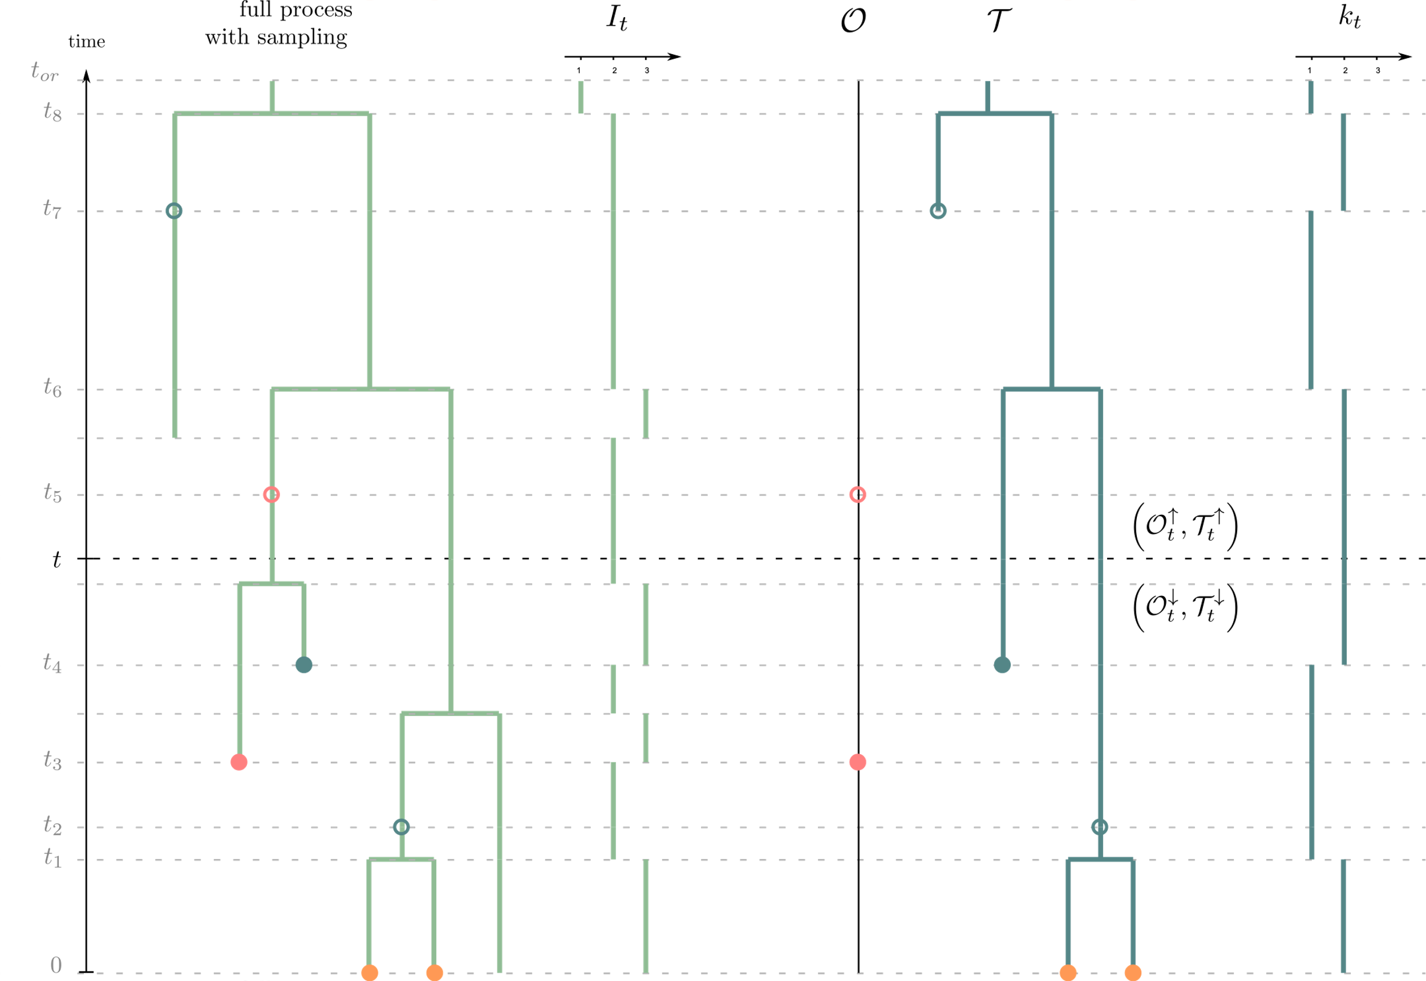
Modèles
Full process with sampling
True diversity
Observed diversity
The Occurrence Birth-Death Process
⇢ Parameters :
$$t_{or}=Time of origin$$
$$λ=Speciation rate$$
$$μ=Extinction rate$$
$$ψ=Fossil sampling rate$$
$$ω=Occurrence sampling rate$$
$$ρ=Sampling probability \\ at present$$
⇢ Objects :
$$𝒯=Tree$$
$$𝒪=Occurrences$$
Manceau, Gupta, Vaughan & Stadler. The probability distribution of the ancestral population size conditioned on the reconstructed phylogenetic tree with occurrence data. Journal of Theoretical Biology (2020)

Slide 28
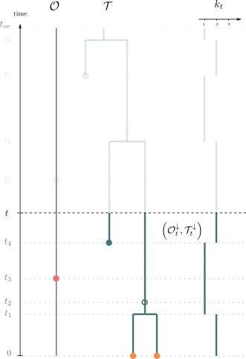
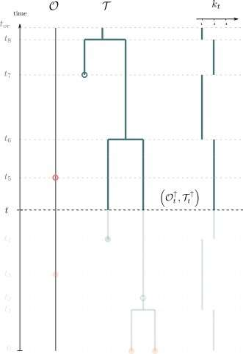







Modèles
$$L_{t}^{(i)}= ℙ({𝒯_{t}^{↓},𝒪_{t}^{↓}|I}_{t}=k_{t}+i)$$
$$M_{t}^{(i)}= ℙ({𝒯_{t}^{↑},𝒪_{t}^{↑},I}_{t}=k_{t}+i)$$
Notations :
$$𝒯=Tree$$
$$𝒪=Occurrences$$
Manceau, Gupta, Vaughan & Stadler. The probability distribution of the ancestral population size conditioned on the reconstructed phylogenetic tree with occurrence data. Journal of Theoretical Biology (2020)
$$k_{t}=Observed diversity$$
$$i=Hidden diversity$$
$$I_{t}=Total diversity$$

Slide 29


Modèles
$$L_{t}^{(i)}= ℙ({𝒯_{t}^{↓},𝒪_{t}^{↓}|I}_{t}=k_{t}+i)$$
$$M_{t}^{(i)}= ℙ({𝒯_{t}^{↑},𝒪_{t}^{↑},I}_{t}=k_{t}+i)$$
$K_{t}^{(i)}= ℙ(I_{t}=k_{t}+i|𝒯,𝒪)∝$ $L_{t}^{(i)}M_{t}^{(i)}$
Notations :
$$𝒯=Tree$$
$$𝒪=Occurrences$$
Manceau, Gupta, Vaughan & Stadler. The probability distribution of the ancestral population size conditioned on the reconstructed phylogenetic tree with occurrence data. Journal of Theoretical Biology (2020)
$$k_{t}=Observed diversity$$
$$i=Hidden diversity$$
$$I_{t}=Total diversity$$

Slide 30

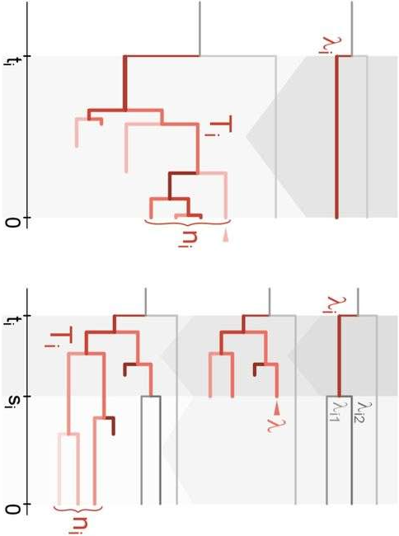
Procédures d’inference – La vraisemblance
M1 – Direct computation
M2 – Data augmentation
Gupta, Manceau, Vaughan, Khammash & Stadler The probability distribution of the reconstructed phylogenetic tree with occurrence data. Journal of Theoretical Biology (2020)
Maliet & Morlon, Fast and Accurate Estimation of Species-Specific Diversification Rates Using Data Augmentation. Systematic Biology (2021)

Slide 31
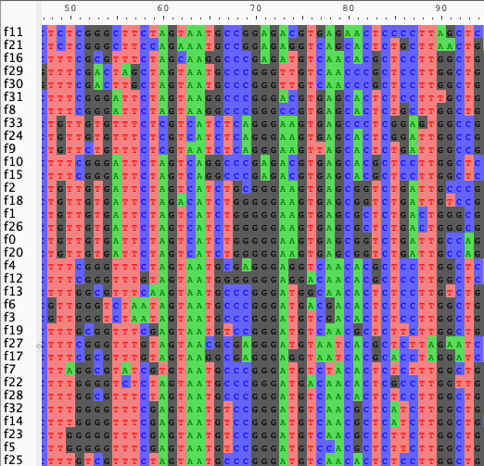
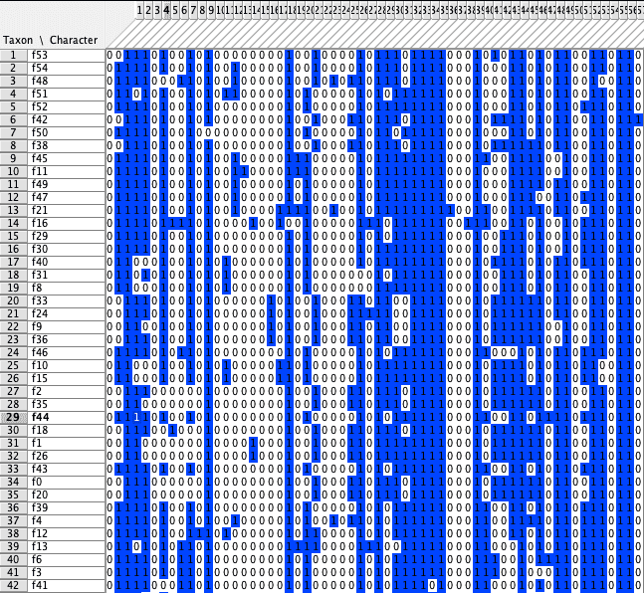

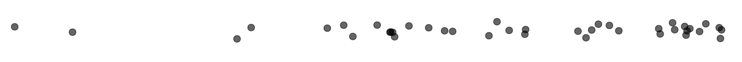
Procédures d’inférence – MCMC
RevBayes
Time
0

Slide 32
Procédures d’inférence – MCMC et post-processing
Workflow: from raw data to phylogenies, model parameters and diversity trajectories
J. Andréoletti, A. Zwaans, et al., The Occurrence Birth-Death Process for combined-evidence analysis in macroevolution and epidemiology. Systematic Biology (2022)

Slide 33
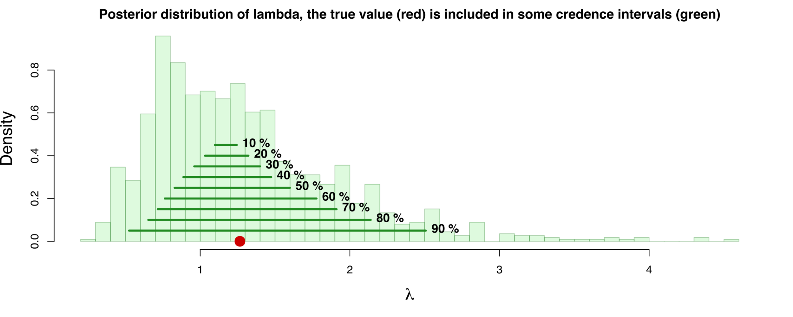
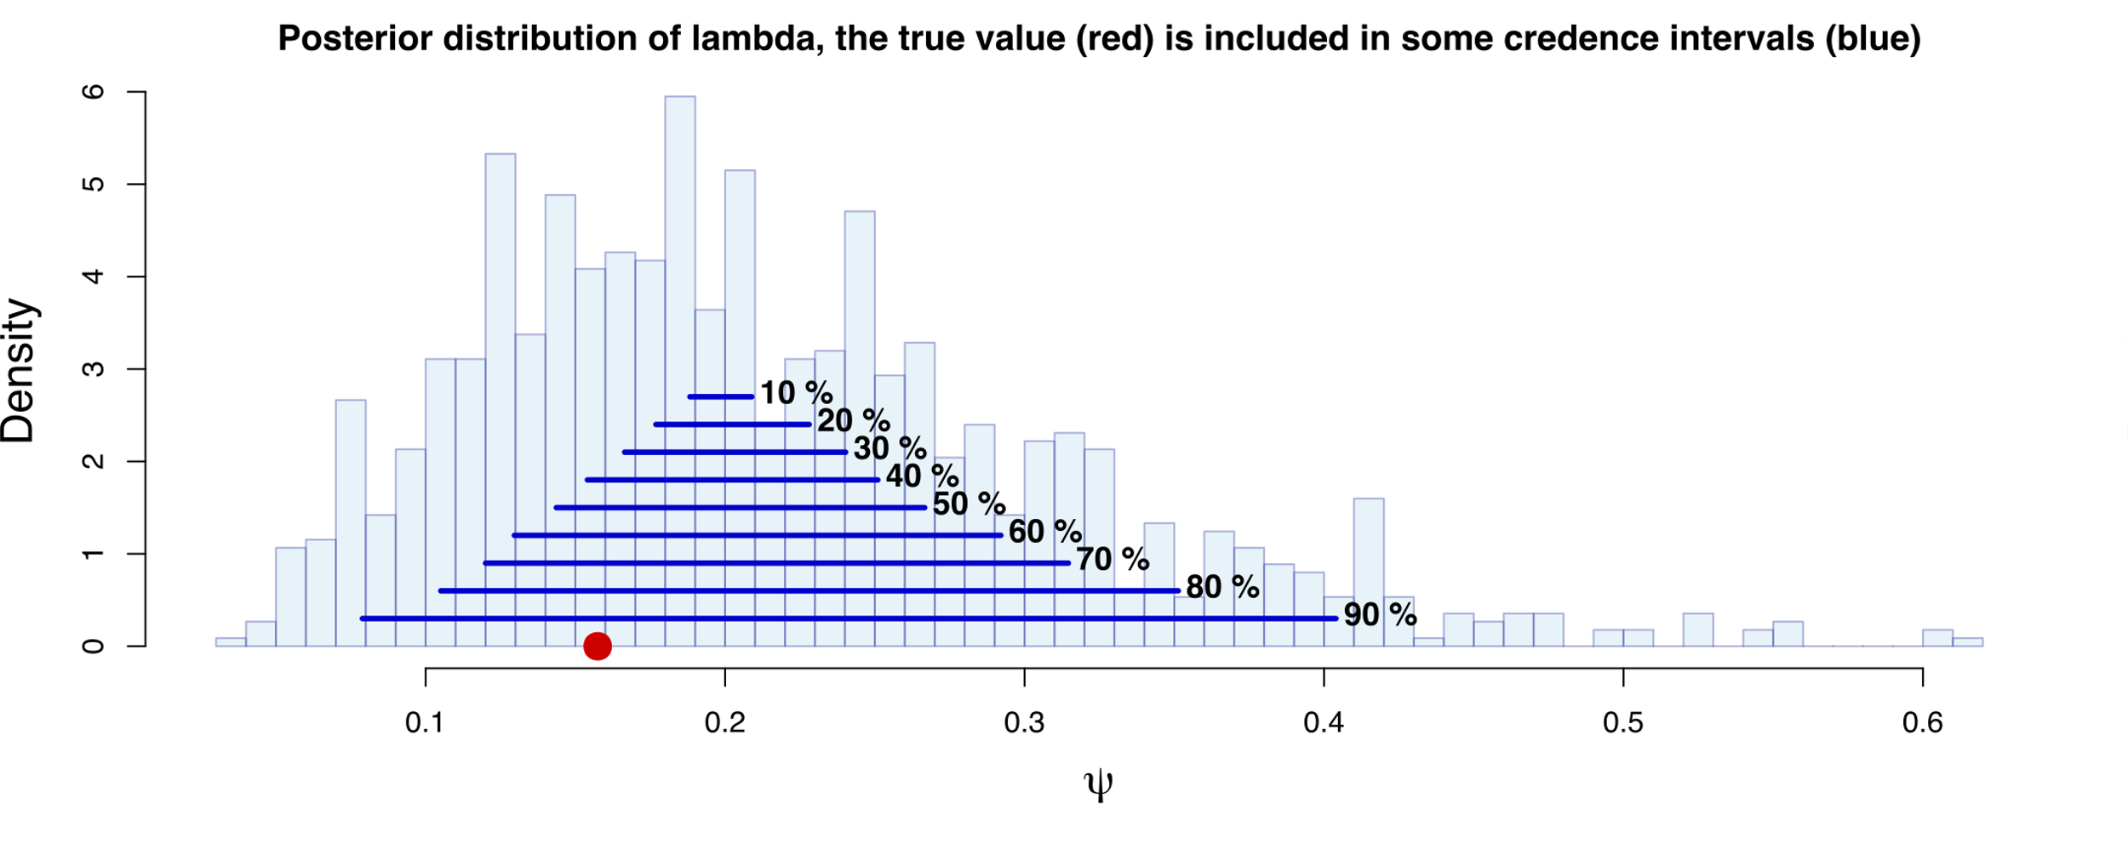
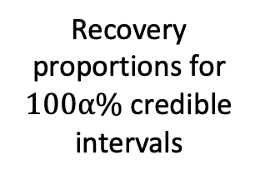
Procédures d’inférence – Calibration
Prior distributions
Parameter | $$λ$$ | $$μ$$ | $$ψ$$ | $$ω$$ | $$t$$ | $$ρ$$
Prior or model | $$𝒢(1, 1)$$ | $$𝒢(1, 1)$$ | $$𝒢(1, 1)$$ | 0.0 | 1.5 | $$1.0$$
Posterior distributions and the $100α\%$ credible intervals compared to the true values (red dot)
1000 simulations
Parameter inference
Recovery proportions for $100α\%$ credible intervals
Andréoletti, Zwaans, et al. 2022

Slide 34

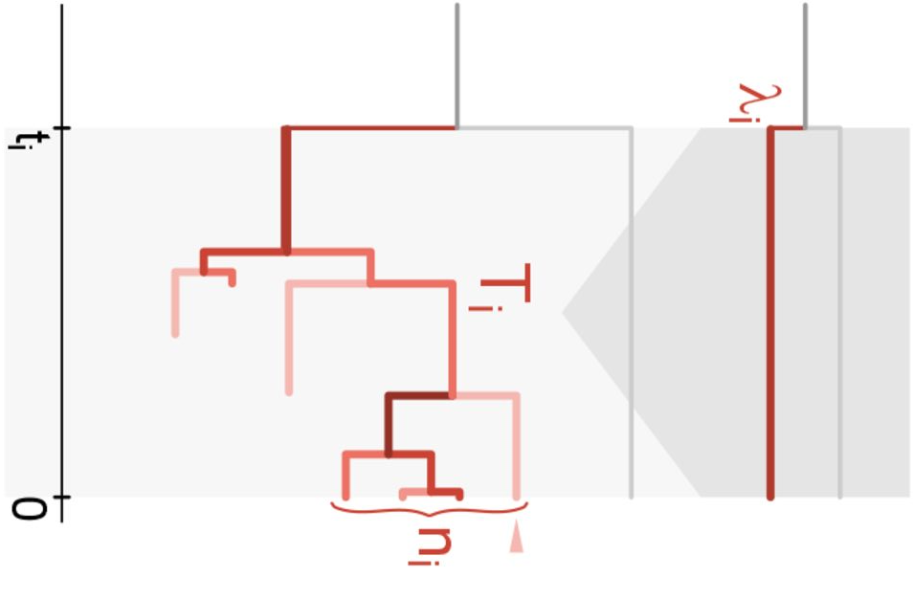
Procédures d’inférence – Augmentation de données
M1 – Direct computation
M2 – Data augmentation
Maliet & Morlon, Fast and Accurate Estimation of Species-Specific Diversification Rates Using Data Augmentation. Systematic Biology (2021)
Augmenting the tree
Updating the parameters
Gupta, Manceau, Vaughan, Khammash & Stadler The probability distribution of the reconstructed phylogenetic tree with occurrence data. Journal of Theoretical Biology (2020)

Slide 35

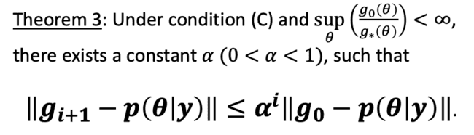

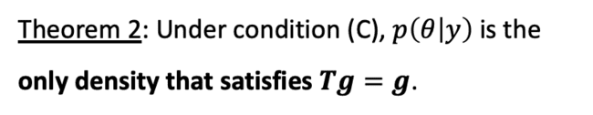
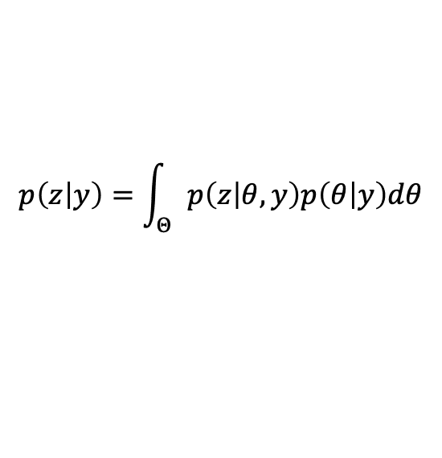
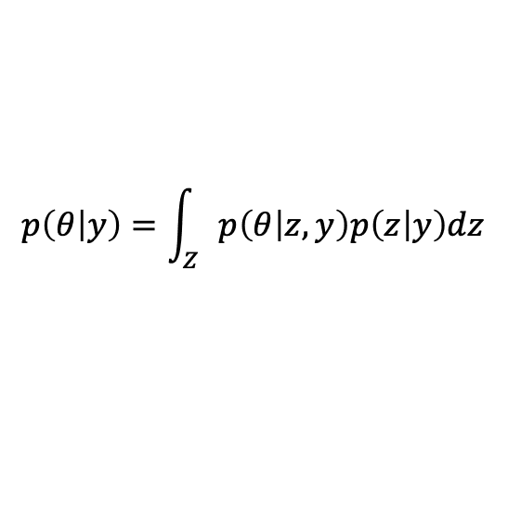
Procédures d’inférence – Augmentation de données
Parameters
Observed data
Latent variables
$$p\left(z | y\right)=\int_{Θ}{p\left(z | θ,y\right)p\left(θ | y\right)dθ}$$
Imputation (Augmenting the tree)
Posterior sampling (Updating the parameters)
$$p\left(θ | y\right)=\int_{Z}{p\left(θ | z,y\right)p\left(z | y\right)dz}$$
$p\left(θ | y\right)$ must satisfy $g\left(θ\right)=\int_{Θ}{\int_{Z}{p\left(θ | z,y\right)p\left(z | φ,y\right)dz}g\left(θ\right)dφ=Tg\left(θ\right)→}$ iterative method $g_{i+1}\left(θ\right)=(Tg_{i})\left(θ\right)$
(C) Uniformly bounded and equicontinuous in $θ$.
Theorem 1: $\left\|g_{i+1}−p\left(θ | y\right)\right\|≤\left\|g_{i}−p\left(θ | y\right)\right\|.$
Theorem 3: Under condition (C) and $\sup_{θ}\left(\frac{g_{0}\left(θ\right)}{g_{∗}\left(θ\right)}\right)<∞$, there exists a constant $α (0<α<1)$, such that
$\left\|g_{i+1}−p\left(θ | y\right)\right\|≤α^{i}\left\|g_{0}−p\left(θ | y\right)\right\|$.
Theorem 2: Under condition (C), $p\left(θ | y\right)$is the only density that satisfies $Tg=g$.
Martin A. Tanner & Wing Hung Wong, The Calculation of Posterior Distributions by Data Augmentation. Journal of the American Statistical Association (1987)

Slide 36
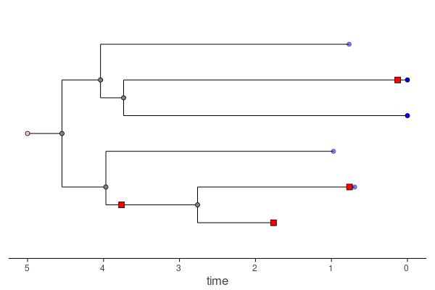
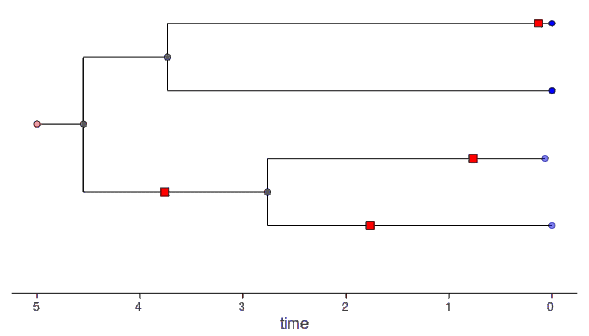


Procédures d’inférence – Augmentation de données
Augmented trees
Reconstructed tree
Ignacio Quintero

Slide 37
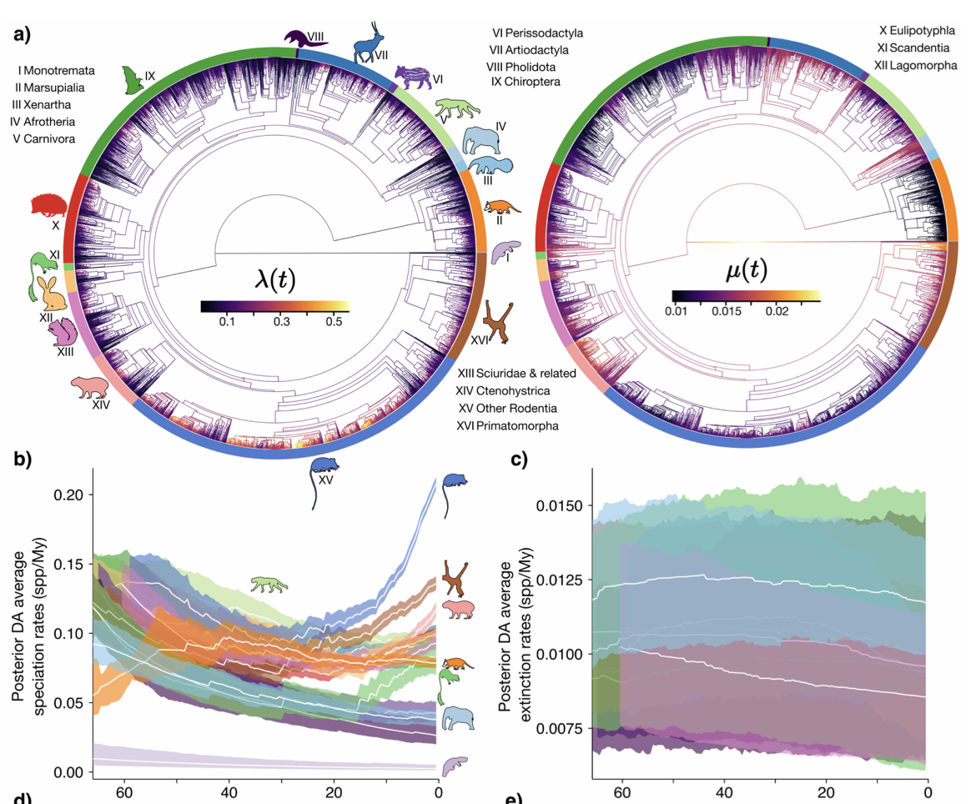

Procédures d’inférence – Augmentation de données
The Birth-Death Diffusion (BDD) model
Geometric Brownian Motion (GBM)
$$dln\text{(}λ_{l}\text{(}\text{t}\text{))}=αdt+σ_{λ}dW(t)$$
Quintero, Lartillot & Morlon, The birth-death diffusion leading to present-day Mammal diversity. Biorxiv (2022)

Slide 38
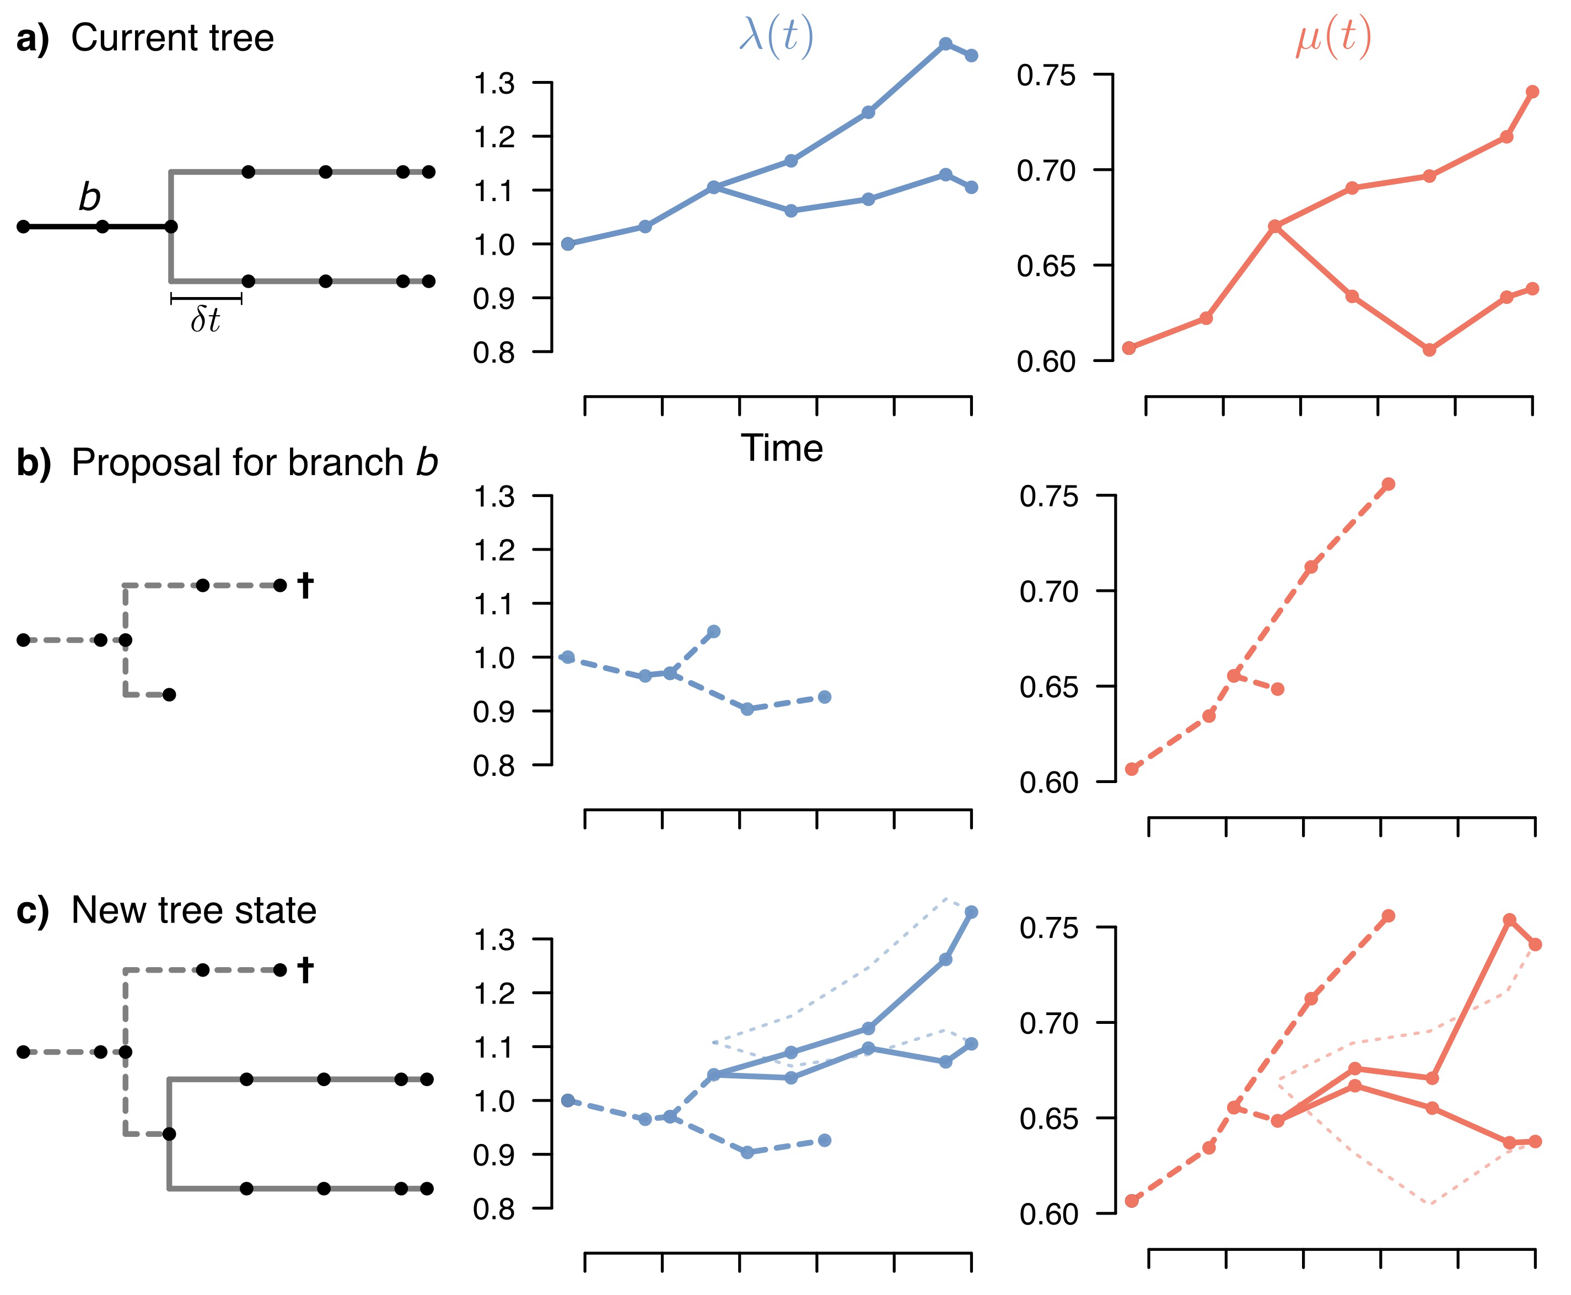
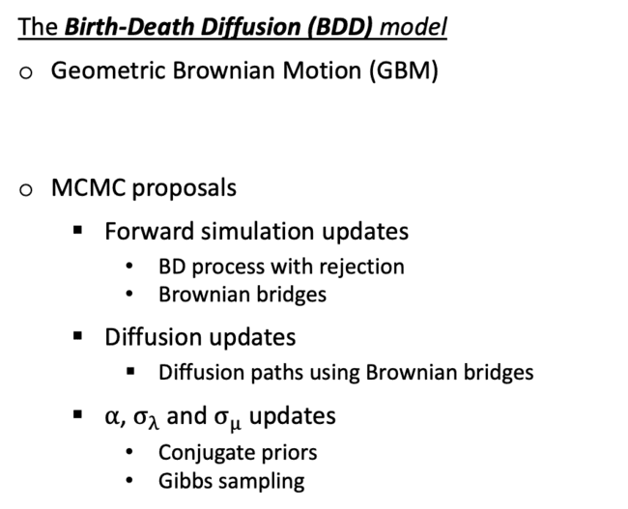
Procédures d’inférence – Augmentation de données
The Birth-Death Diffusion (BDD) model
Geometric Brownian Motion (GBM)
MCMC proposals
  Forward simulation updates
    BD process with rejection
    Brownian bridges
  Diffusion updates
    Diffusion paths using Brownian bridges
  $α$, $σ_{λ}$ and $σ_{μ}$ updates
    Conjugate priors
    Gibbs sampling
$$dln\text{(}λ_{l}\text{(}\text{t}\text{))}=αdt+σ_{λ}dW(t)$$
Quintero, Lartillot & Morlon, The birth-death diffusion leading to present-day Mammal diversity. Biorxiv (2022)

Slide 39
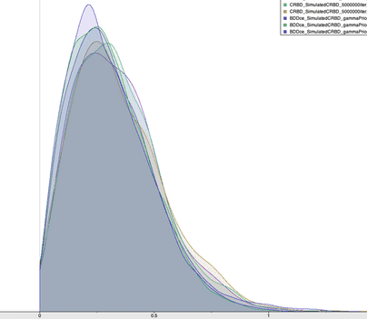
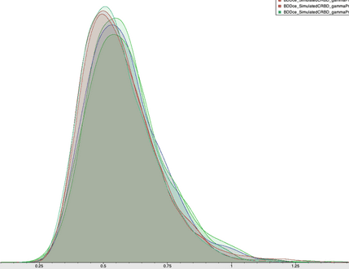



Procédures d’inférence – Vérification inter-modèles
Objectif : vérifier que les modèles complexes convergent vers les modèles simples dans les conditions attendues
BDDce
CRBD
$$σ_{λ}→0$$
$$α_{λ}→0$$
CRBD
$$λ_{0}$$
$$μ$$
17

Slide 40
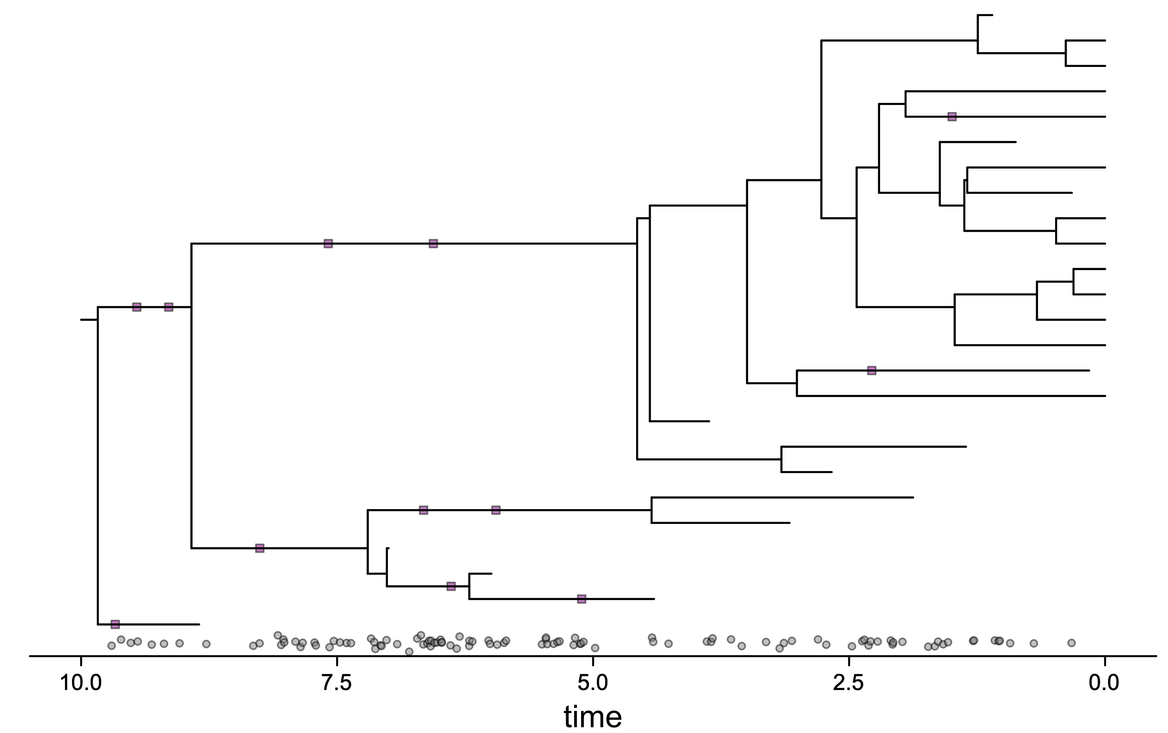
Procédures d’inférence – Avancées en cours

Slide 41
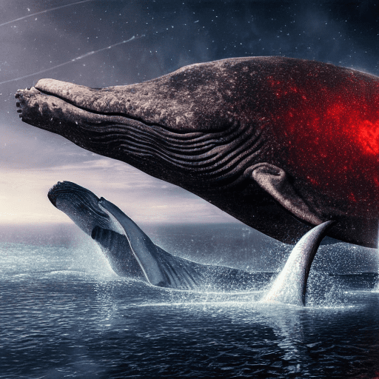
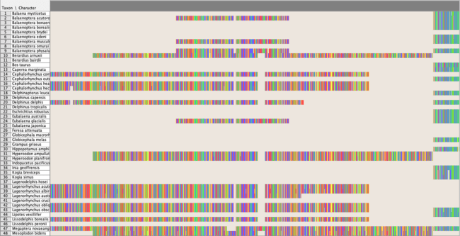
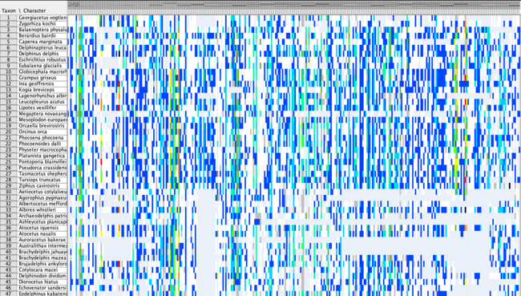
Applications empiriques– Cétacés
(8765 nt. nuclear sequences + 7410 nt. mitochondrial sequences) x 87 extant taxa
327 morphological characters x (27 extant + 90 fossil taxa)
Time
RevBayes
0
968 fossil occurrences
Notes:
Rachel Warnock & Gabriel Aguirre Fernandez

Slide 42
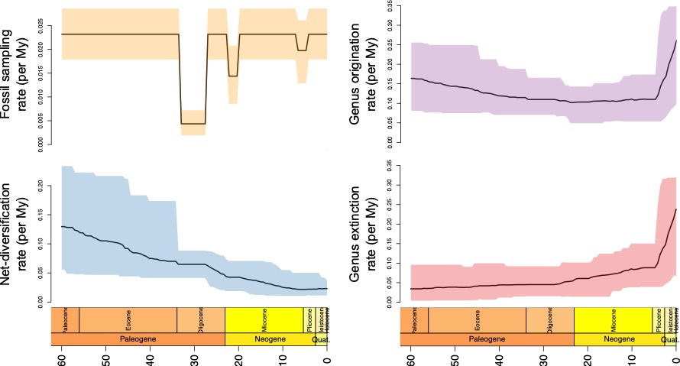
Applications empiriques– Cétacés
Diversification and sampling rates
Inferred number of genera
Expectation
95% credence interval
LTT
Andréoletti, Zwaans, et al., Systematic Biology (2022)

Slide 43

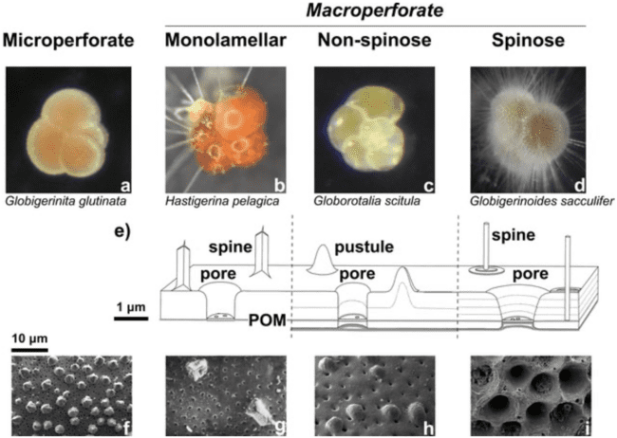
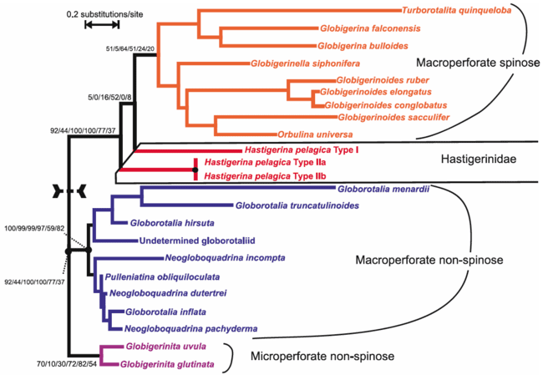
Applications empiriques– Foraminifères
~48 modern morphotypes
~250 genotypes
20

Slide 44
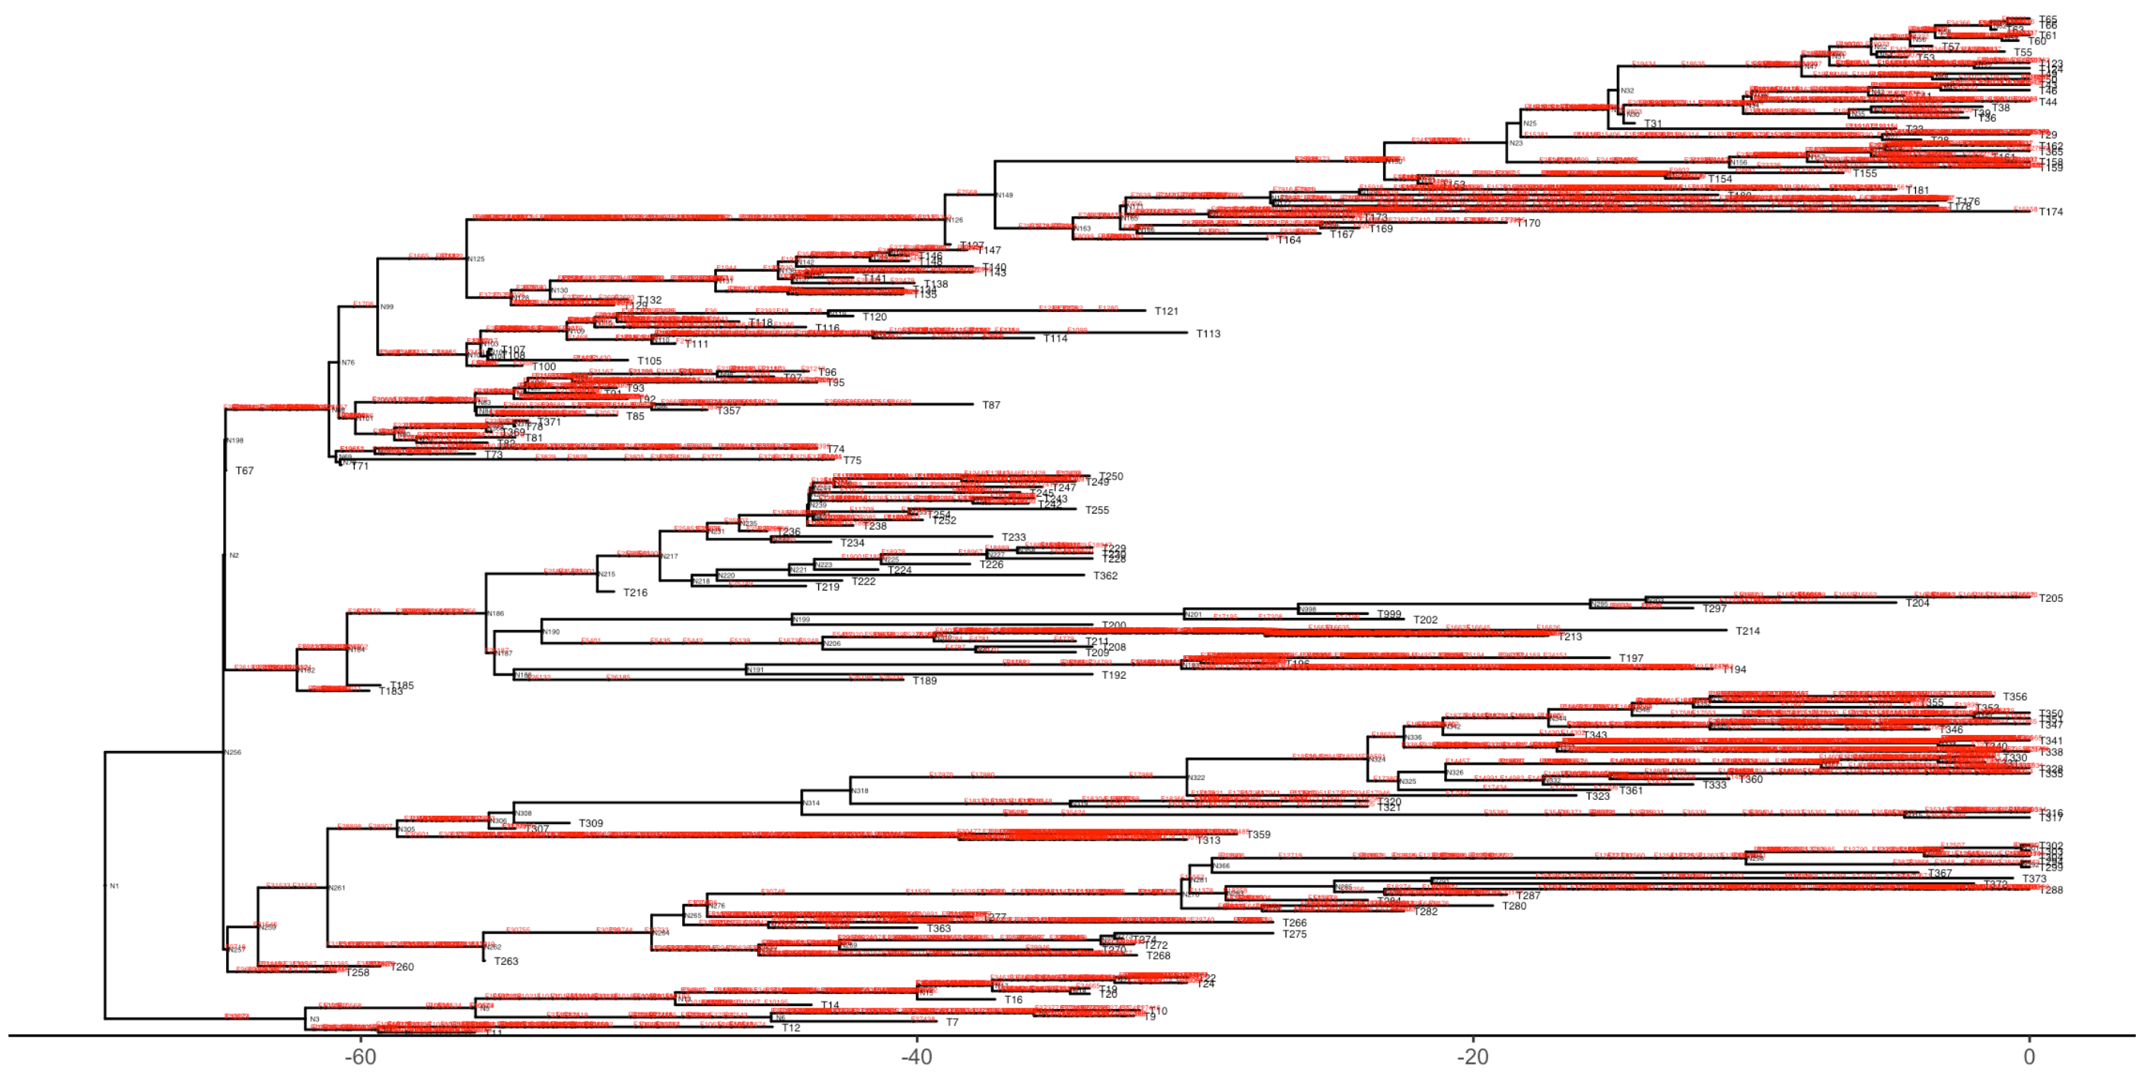
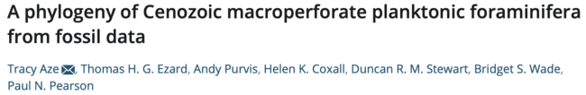
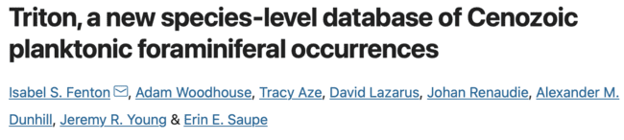
Applications empiriques– Foraminifères
The “One True Tree” + 5000 fossils
(2011)
(2021)
21

Slide 45
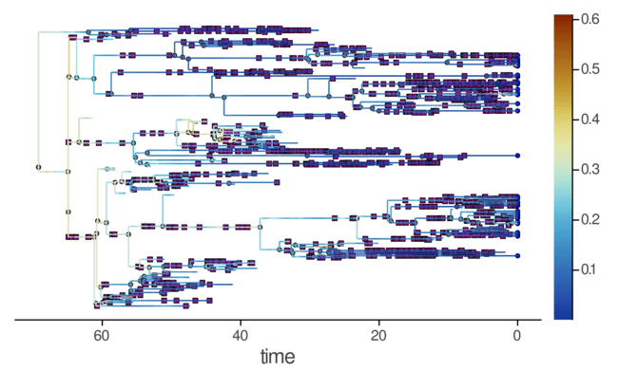





Applications empiriques– Foraminifères
Net diversification rate
Speciation rate
LTT
Extinction rate
22

Slide 46





Perspectives and other projects
Langages de Programmation probabilistes
Problèmes d’identifiabilité : explorer les classes de congruence
Comparaisons de taux d’extinction

Slide 47




Thank you for your attention !
Notes:
Particular thanks to MM and RW that are wonderfully mentoring Antoine Zwaans and me on this project !

Slide 49
Implementation
RevBayes

Slide 50


Implementation
OBDP parameter priors
Additional parameters
Tree prior distribution
RevBayes

Slide 51
Implementation
RevBayes

Slide 52
Implementation
RevBayes

Slide 53

Past Cetacean diversity – Fossil record
3
Mysticetes
Odontocetes
2
Archaeocetes
1
Marx et al. 2016
Cetacean generic diversity over geological time
Notes:
Rachel Warnock & Gabriel Aguirre Fernandez

Slide 54


Past Cetacean diversity – Fossil record
Paleobiology Database
Mysticetes
Odontocetes
Marx et al. 2016
Archaeocetes
Marx et al. 2016
Cetacean generic diversity over geological time
The cetacean fossil record
Notes:
Rachel Warnock & Gabriel Aguirre Fernandez

Slide 55


Past Cetacean diversity – Fossil record
Aggregated
Paleobiology Database
Homogenized
Mysticetes
Initial occurrence distribution
Odontocetes
Marx et al. 2016
Archaeocetes
Marx et al. 2016
Cetacean generic diversity over geological time
The cetacean fossil record
Distribution of occurrence and
bias corrections
Notes:
Rachel Warnock & Gabriel Aguirre Fernandez

Slide 56





Foraminifera – Hole-based subsampling
1) Homogenize the number of samples per hole
2) Homogenize the number of holes
3) Subsample the densest holes

Slide 57


Foraminifera – Heterogeneity in fossil sampling
Normal distribution of fossil samples over a species' lifetime
Notes:
Rachel Warnock & Gabriel Aguirre Fernandez

Slide 58

Foraminifera – Heterogeneity in fossil sampling
Generalized additive model explaining fossil sampling heterogeneity
Notes:
Rachel Warnock & Gabriel Aguirre Fernandez

Slide 59


Foraminifera – Heterogeneity in fossil sampling
Variance partitioning
Phylogenetic signal
Notes:
Rachel Warnock & Gabriel Aguirre Fernandez

