Slide 1
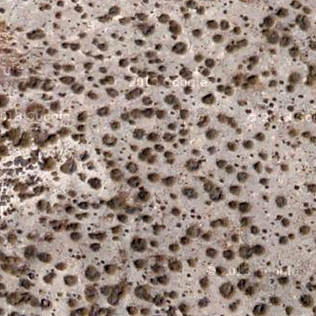
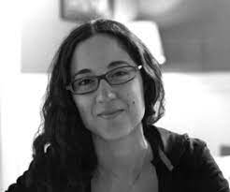
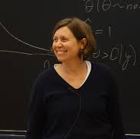
Estimating distances to desertification points from dryland ecosystem images
Benoît Pichon, Sophie Donnet Isabelle Gounand, Sonia Kéfi
Aussois 2024

Slide 2
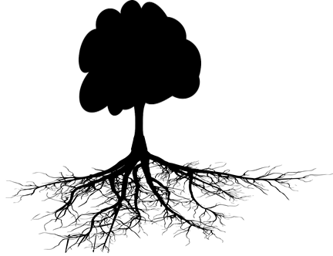
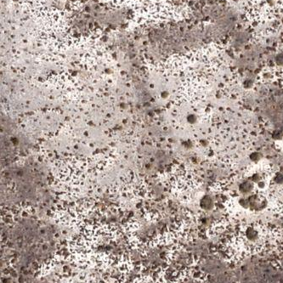
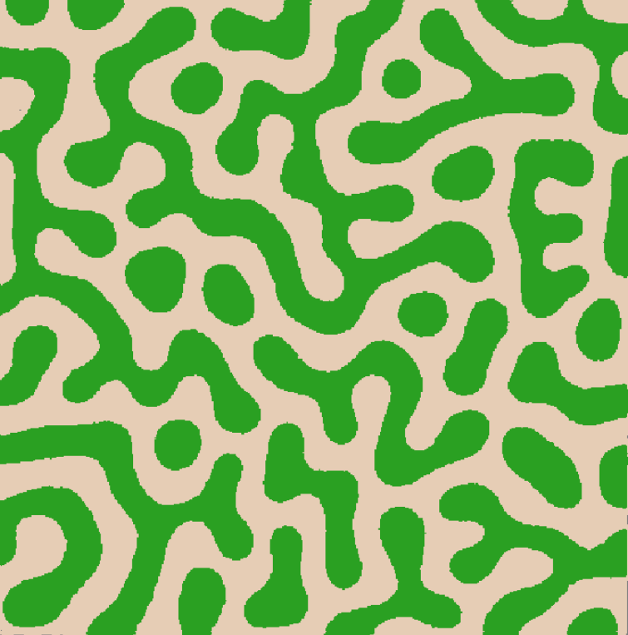
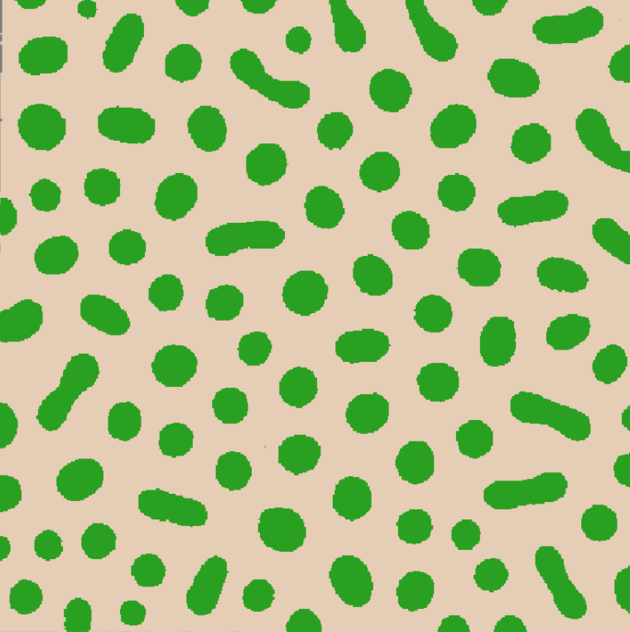
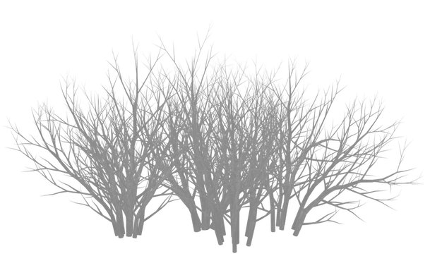
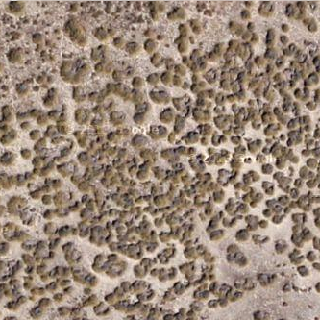
Spatial patterns emerge from local feedbacks
Crown range
Facilitating sp.
Beneficiaries sp.
Root system range
+
Vegetation cover
x
Increase in infiltration, soil moisture
Shading, limiting evaporation
Seed trap, proxichory
Aridity
Bruno et al., TREE 2003
Callaway 2007
Flores & Jurado, J. vege. science 2003
Koffel et al., Eco. Mono. 2021
2

Slide 3
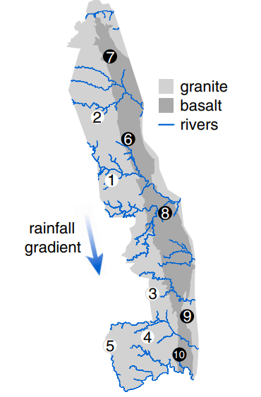
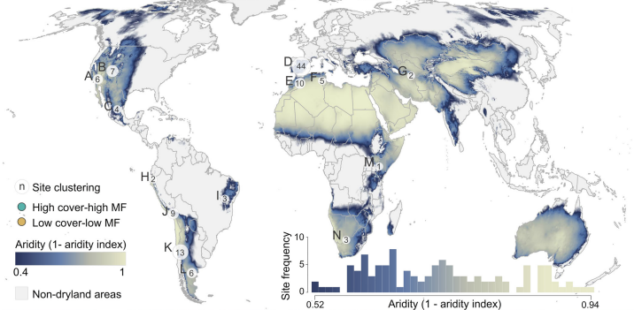
Questions
Spatial indicator
Aridity/ Rainfall
Staver et al., PNAS 2019
But: all sites are different and experience different local environmental conditions
=
Different response to increasing stress
Kéfi et al., PNAS 2024
3

Slide 4
Questions
Vegetation cover
Aridity
Can we quantify the resilience of drylands at the site-level?
4

Slide 5
Questions
Different environmental conditions
=
different responses to the ecosystems
Vegetation cover
Aridity
Can we quantify the resilience of drylands at the site-level?
Can we put all observations on the same scale ?
5

Slide 6
Using a minimal model to make quantitative predictions
Observation
Inferring model parameters
Current state
Vegetation cover
Model parameter
6

Slide 7
A minimal model of self-organized patterns
=
7

Slide 8
A minimal model of self-organized patterns: rules
p
1-p
Parameters
p=reproduction
q=positive feedback
1-q
q
Lübeck J. of Stat. Phys. 2006
Eby et al., Global Ecol. & Biogeo. 2017
8

Slide 9
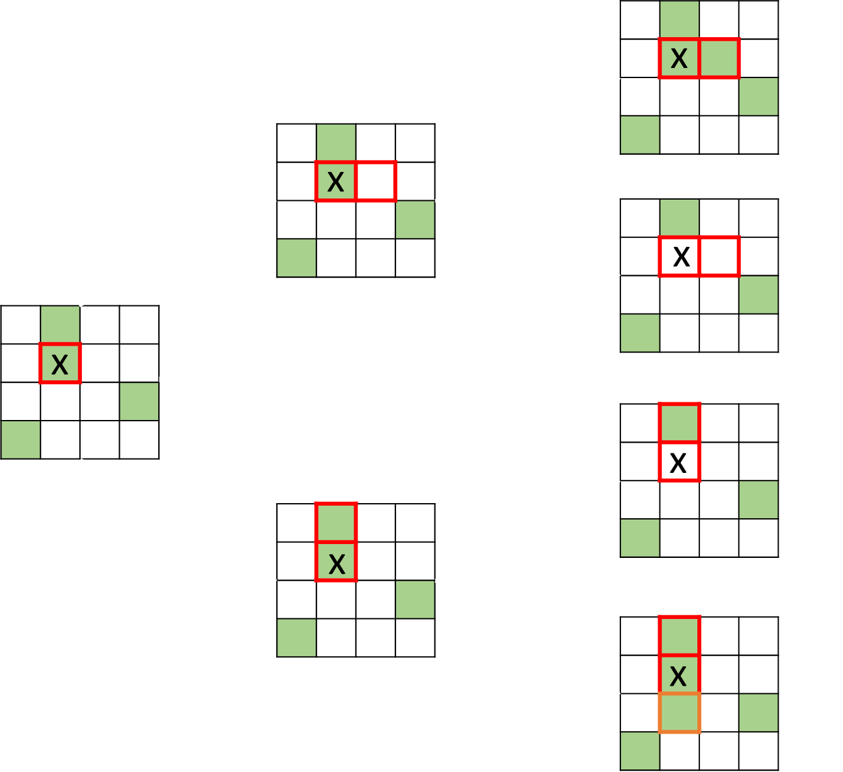
A minimal model of self-organized patterns: rules
Lanscape at time t
p
1-p
Parameters
p=reproduction
q=positive feedback
1-q
q
Lübeck J. of Stat. Phys. 2006
Eby et al., Global Ecol. & Biogeo. 2017
9

Slide 10
A minimal model of self-organized patterns: rules
Lanscape at time t
Lanscape at time t+1
Event
p
Recruitment of plant
1-p
Mortality of plant
Parameters
p=reproduction
q=positive feedback
1-q
q
Lübeck J. of Stat. Phys. 2006
Eby et al., Global Ecol. & Biogeo. 2017
10

Slide 11
A minimal model of self-organized patterns: rules
Lanscape at time t
Lanscape at time t+1
Event
p
Recruitment of plant
1-p
Mortality of plant
Parameters
p=reproduction
q=positive feedback
1-q
q
Lübeck J. of Stat. Phys. 2006
Eby et al., Global Ecol. & Biogeo. 2017
11

Slide 12
A minimal model of self-organized patterns: rules
Lanscape at time t
Lanscape at time t+1
Event
p
Recruitment of plant
1-p
Mortality of plant
Parameters
p=reproduction
q=positive feedback
1-q
q
Lübeck J. of Stat. Phys. 2006
Eby et al., Global Ecol. & Biogeo. 2017
12

Slide 13
A minimal model of self-organized patterns: rules
Lanscape at time t
Lanscape at time t+1
Event
p
Recruitment of plant
1-p
Mortality of plant
Parameters
p=reproduction
q=positive feedback
1-q
Mortality of plant
q
Facilitation for recruitment
Lübeck J. of Stat. Phys. 2006
Eby et al., Global Ecol. & Biogeo. 2017
13

Slide 14
Model behavior
14

Slide 15
Mean-field phase-diagram
$\frac{dV}{dt}=V\left(2p−1\right)+2V^{2}\left(q−p\right)−V^{3}q$
Saade et al., Am’ Nat’ 2022
Villa Martin et al. PNAS 2015
15

Slide 16
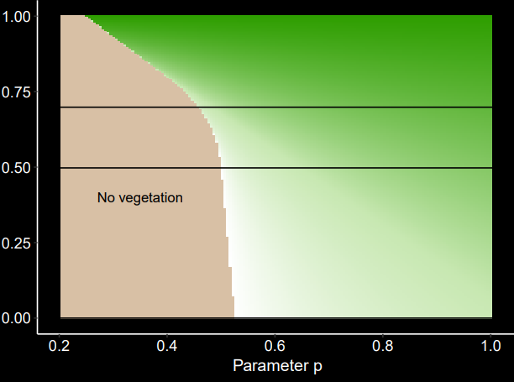
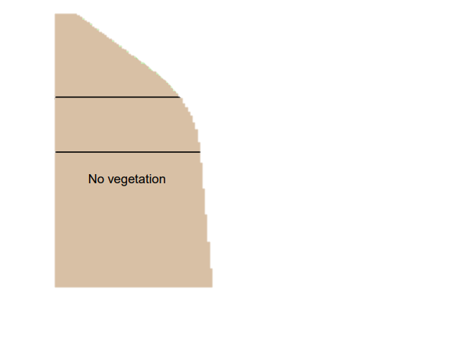
Mean-field phase-diagram
Vegetation cover
0 0.5 1
q = local positive feedback
p = reproduction (1-mortality)
16

Slide 17
Mean-field phase-diagram
Vegetation cover
0 0.5 1
q = local positive feedback
High q
Low q
p = reproduction (1-mortality)
17

Slide 18
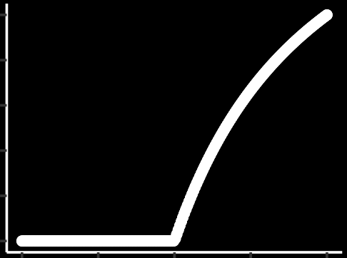
Mean-field phase-diagram
Vegetation cover
0 0.5 1
q = local positive feedback
Vegetation cover
q=0
p = reproduction (1-mortality)
p = reproduction (1-mortality)
18

Slide 19
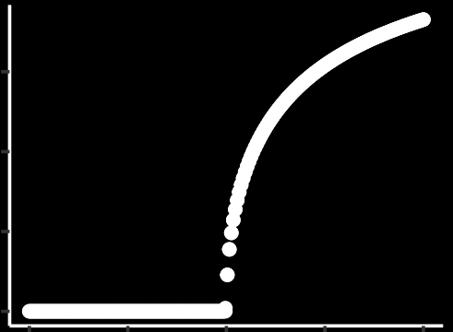
Mean-field phase-diagram
Vegetation cover
0 0.5 1
q = local positive feedback
Vegetation cover
p = reproduction (1-mortality)
p = reproduction (1-mortality)
19

Slide 20
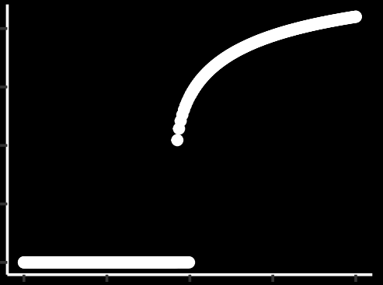
Mean-field phase-diagram
Vegetation cover
0 0.5 1
q = local positive feedback
Vegetation cover
p = reproduction (1-mortality)
p = reproduction (1-mortality)
20

Slide 21
Ability to generate spatial structure close to observed ones
Observation
Simulation

Slide 22
Using a minimal model to make quantitative predictions
Observation
Inferring model parameters
p = ?
q = ?
Current state
Vegetation cover
Model parameter
22

Slide 23
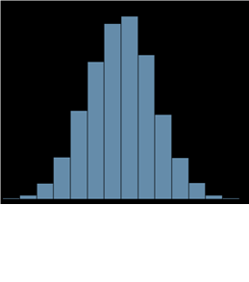
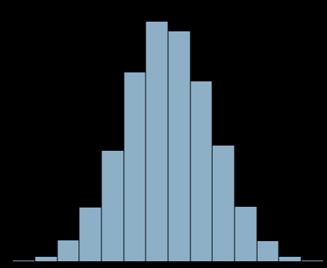
Approximate Bayesian Computing for vegetation landscapes
A model
Closest simulations kept
p = reproduction
q = local positive
feedback
+ Scale layer
x
x
Accepted simulations
x
x
x
x
Observation
x
x
x
x
x
x
Observation
Simulating over parameter space
p_{est}
p_{c}
Vegetation cover
x
Dist
Dist
p_{est}
q_{est}
p
Beaumont et al., Genetics, 2002
Marjoram et al., PNAS 2003
Hartig et al., Biogeoscience 2014
Environmental gradient
23

Slide 24
Using a minimal model to make quantitative predictions
Observation
Inferring model parameters
Current state
Vegetation cover
Model parameter
24

Slide 25
Validation using simulations

Slide 26
Validating the method using simulations
Vegetation
Mussel
Degraded
Empty
Degraded
Empty
+
+
Kéfi et al., TPB 2007
Guichard et al., Am’ Nat’ 2003
Pascual and Guichard, 2005

Slide 27
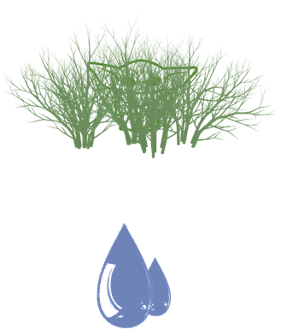
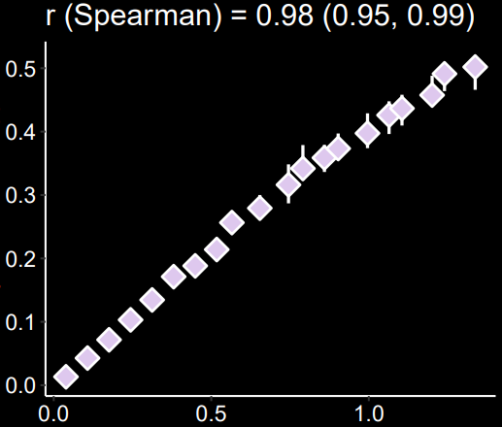
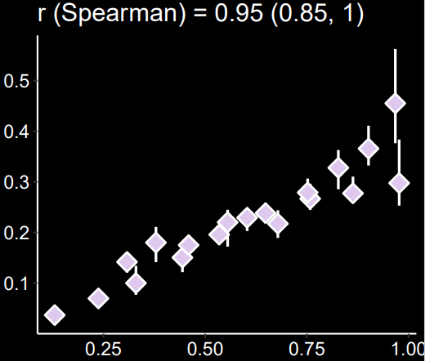
Comparing theoretical predictions with estimated ones
Theoretical distance
Estimated distance using our approach
Comparing distances: does the inference method works on simulations?
Vegetation cover
Vegetation cover
Decreasing recruitment
Decreasing reproduction (p)
Dryland model
Mussel-bed model
Estimated distance using our approach
Theoretical distance (using the model)
27

Slide 28
On simulations
OK
Now on dryland images

Slide 29
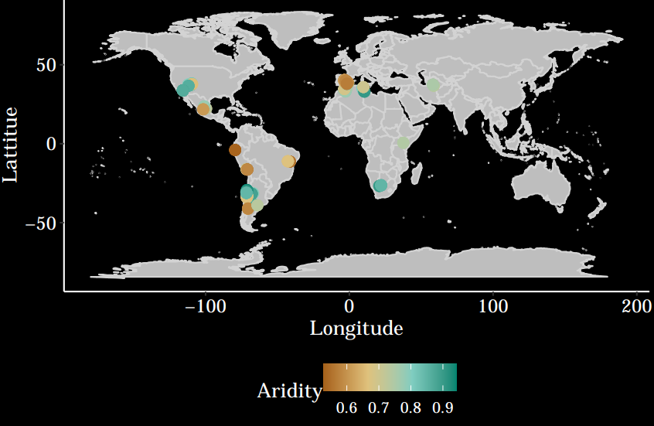
Dataset on global drylands
Remotely sensed vegetation landscapes
50m
Maestre et al., 2012
Aridity = Precipitation/evapotranspiration
29

Slide 30
Simulating desertification
Observed landscape

Slide 31
Simulating desertification
Observed landscape
Accepted landscape (example)

Slide 32
Simulating desertification
Observed landscape
Accepted landscape (example)
Simulated landscapes
Increasing stress levels

Slide 33
Simulating desertification
Observed landscape
Accepted landscape (example)
Simulated landscapes
Increasing stress levels

Slide 34
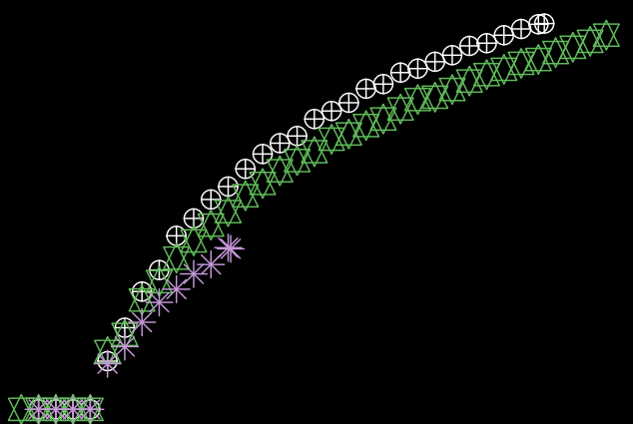
Putting all landscapes on the same scale
Vegetation cover
0
Distance to desertification point (along p)

Slide 35
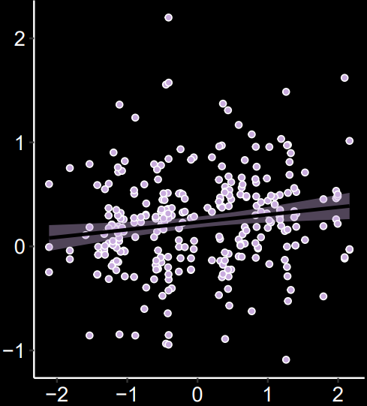
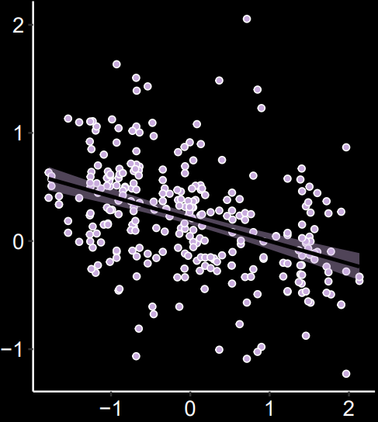
Drivers of the resilience of global drylands
Distance to desertification point
Multifunctionality
Aridity
C
P
N

Slide 36
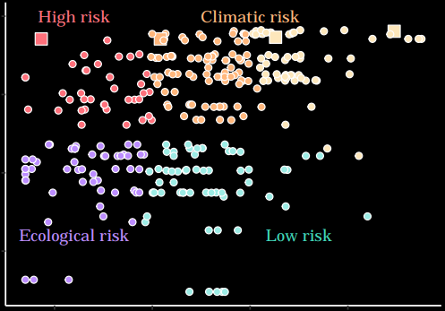
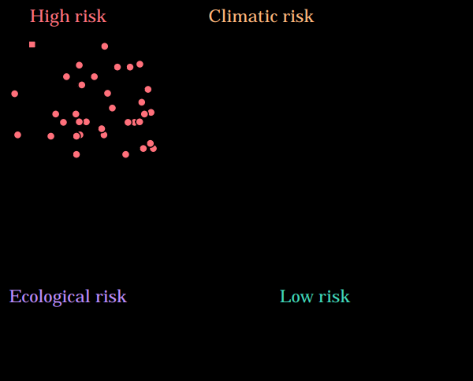
Crossing with climate projection to pinpoint most fragile areas
Projected change in aridity in the next decades (RCP 8.5)
Distance to desertification point

Slide 37
Crossing with climate projection to pinpoint most fragile areas
Projected change in aridity in the next decades (RCP 8.5)
Distance to desertification point

Slide 38
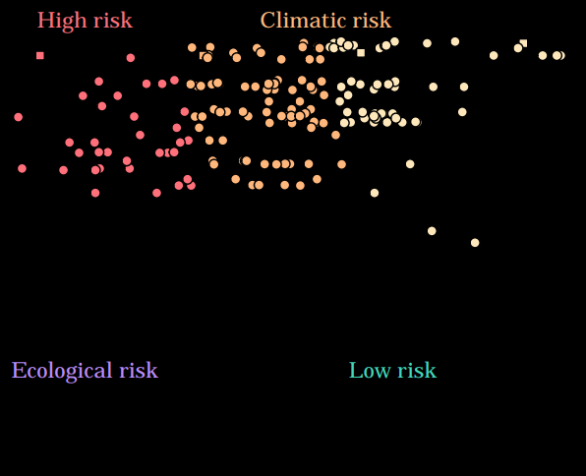
Crossing with climate projection to pinpoint most fragile areas
Projected change in aridity in the next decades (RCP 8.5)
Distance to desertification point

Slide 39
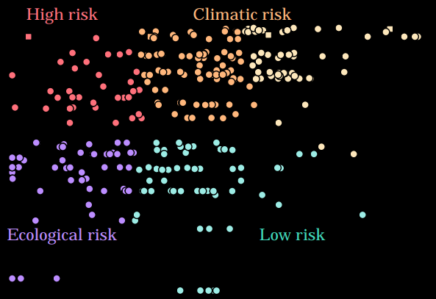
Crossing with climate projection to pinpoint most fragile areas
Projected change in aridity in the next decades (RCP 8.5)
Distance to desertification point

Slide 40
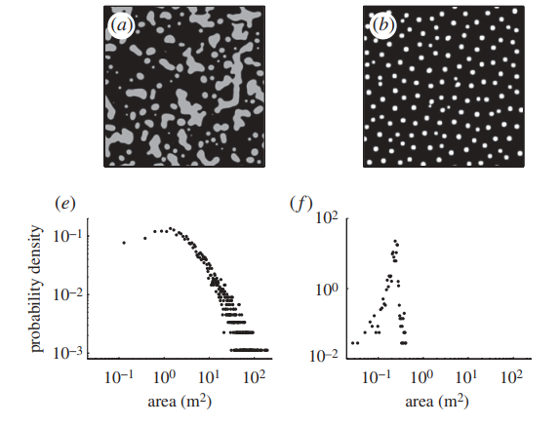
Limitations
v
x
Can be applied on scale-free spatial patterns but not regular ones…
… and for systems which alternative state is desert
Difficulty to interpret quantitatively the estimated resilience
von Hardenberg et al., Proc B, 2010

Slide 41
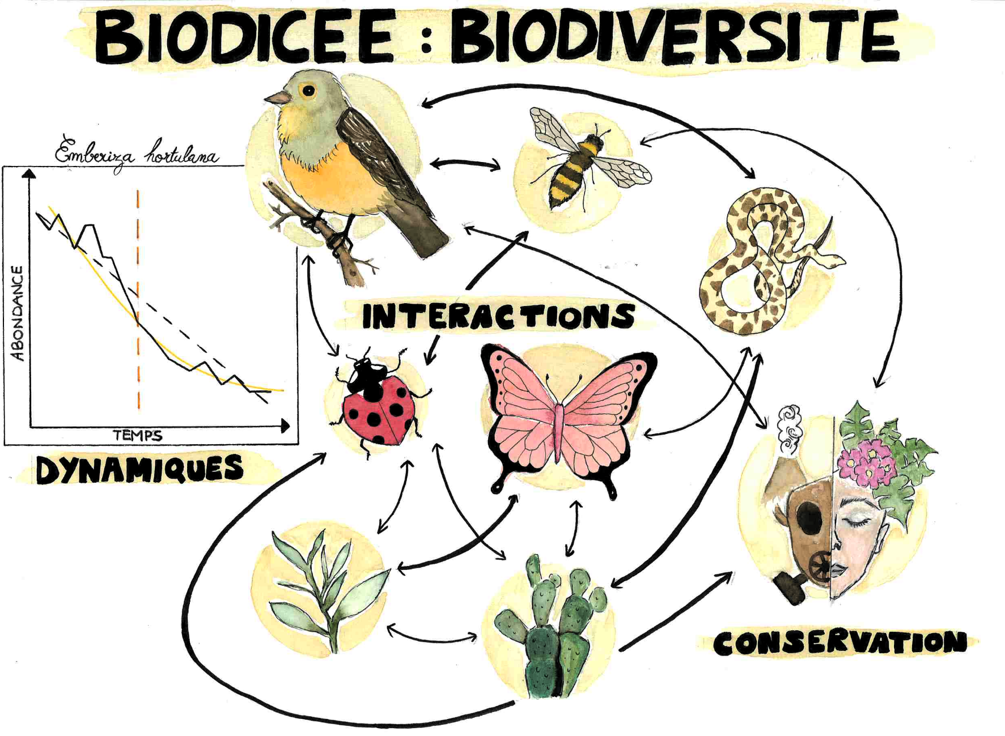
Sonia Kéfi, Sophie Donnet, Isabelle Gounand
Ismaël Lajaaiti & Jean-François Arnoldi
Nicolas Loeuille, Tanguy Daufresne, Nicolas Gross & BioDiCée team for discussions
Chaire MMB for the funding

Slide 42
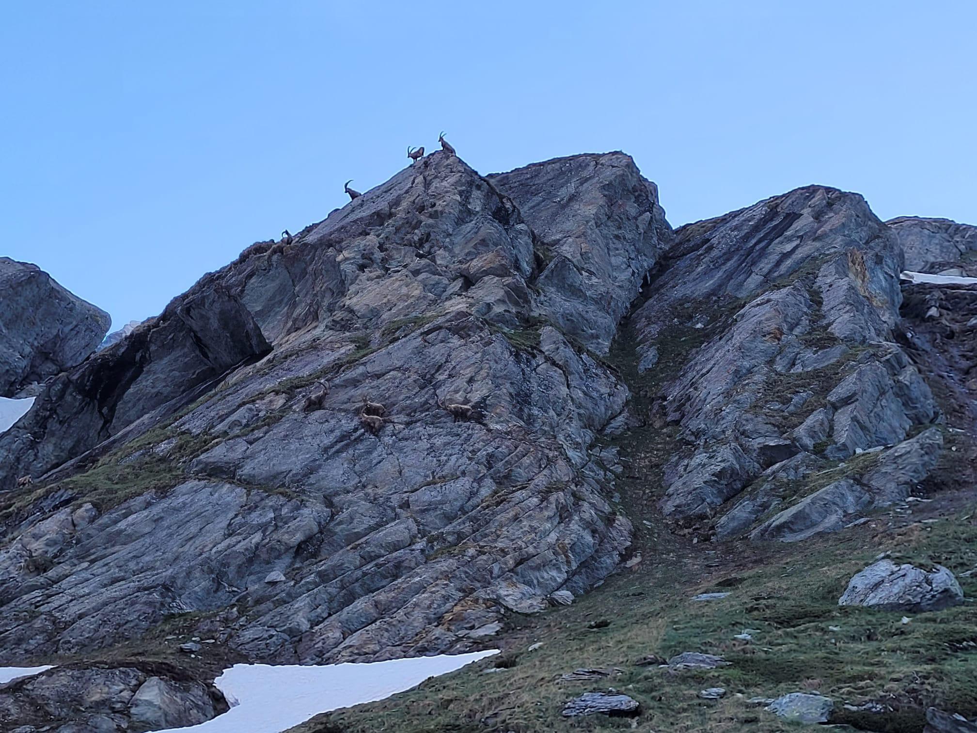
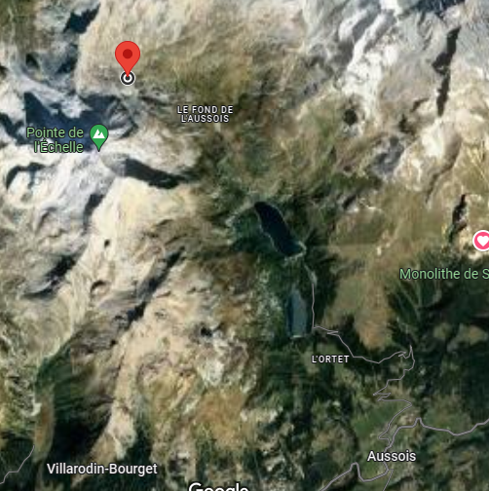
Thank you for your attention!
Prises par Gaël ce matin

Slide 43
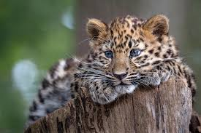
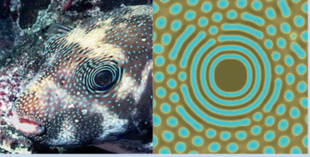
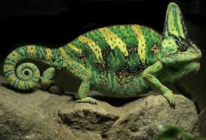
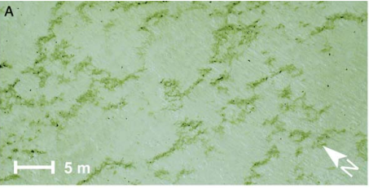
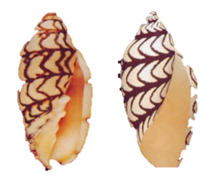
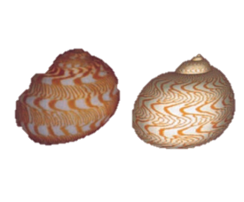
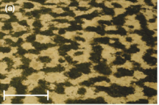
Rietkerk & van de Koppel, TREE 2008
Kondo and Miura, Science 2010
Van der Heide et al., Ecology 2010
43

Slide 44
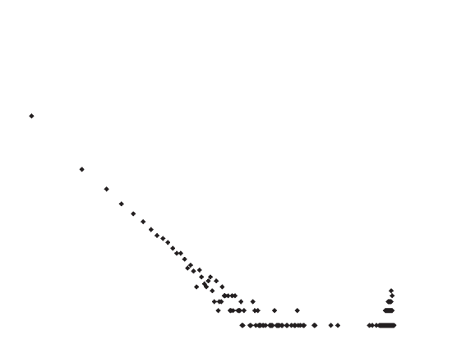
Patch-size distribution as an indicator of resilience loss
Number of patches
Size of the patches
44

Slide 45
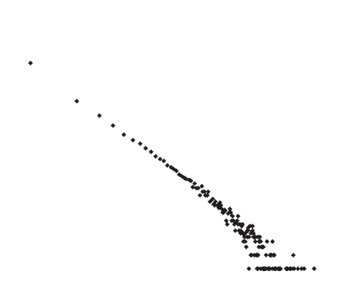
Patch-size distribution as an indicator of resilience loss
Aridity
Loss of patches connectivity
Number of patches
Size of the patches
45

Slide 46
Patch-size distribution as an indicator of resilience loss
Aridity
Loss of patches connectivity
Loss of big patches
-> deviation from power-law
Number of patches
Size of the patches
46

Slide 47
Ability to generate spatial structure close to observed ones (?)

Slide 48
Ability to replicate observed spatial structures
Level of aggregation
Vegetation cover
Patch size distribution
Autocorrelation
Variance
Spectral ratio
Biggest patch
a
a
Coefficient variation patch size
Fit on the patch size distribution
48

Slide 49
Ability to replicate observed spatial structures?
Simulated
49

Slide 50
Ability to replicate observed spatial structures?
Observed site
Simulated
50

Slide 51
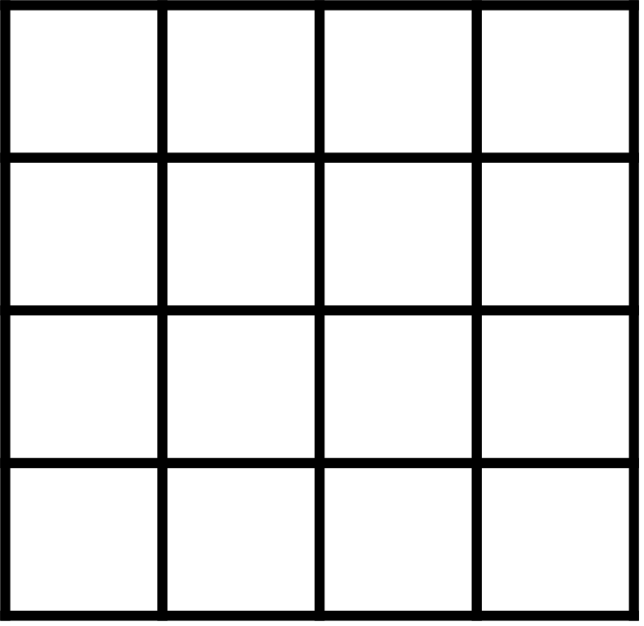
But issue: mismatch of scales between model and observations
Scale of the model: a pixel corresponds to a plant
51

Slide 52
But issue: mismatch of scales between model and observations
Scale of the model: a pixel corresponds to a plant
Scale of the observation: a pixel does not correspond to a plant
52

Slide 53
Adding a scale parameter
53

Slide 54
Ability to replicate observed spatial structures
Different values of the scale parameter
PC 2 (24.6%)
PC 3 (13.7%)
PC 3 (13.7%)
PC 1 (49.3%)
PC 1 (49.3%)
PC 2 (24.6%)
54

Slide 55
Comparing observations and simulations
Observed
Simulated from the posteriors

Slide 56
What is lacking ?
56

Slide 57
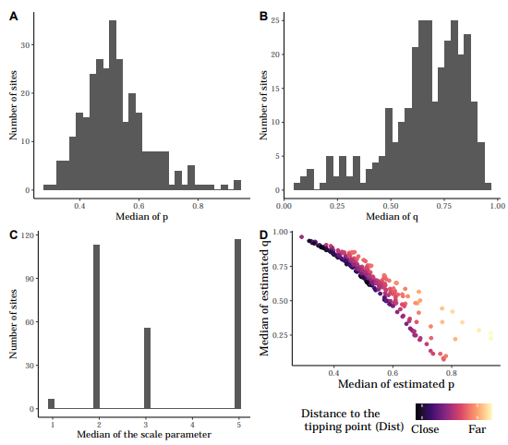

Slide 58
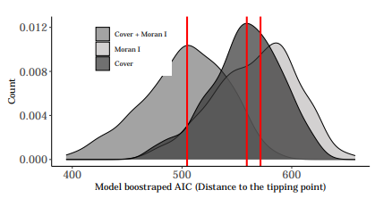

Slide 59
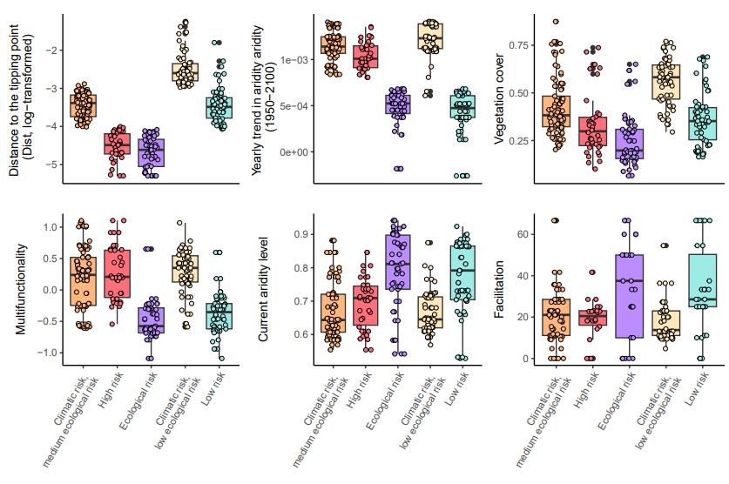

Slide 60
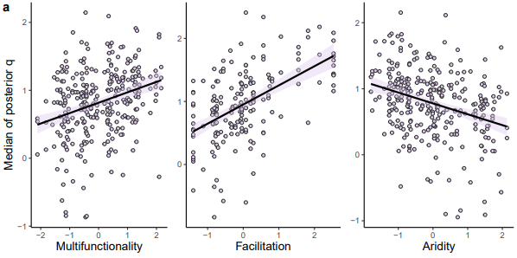

Slide 61
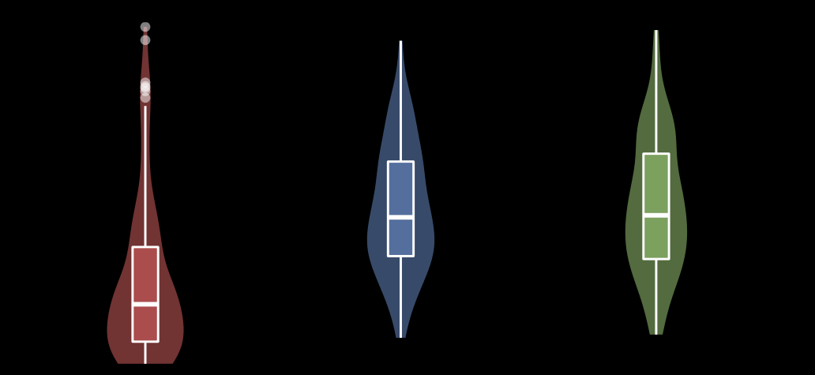
Learning similarity of vegetation structure within each site
1
0.75
Distance within site / between sites
0.5
0.25
0
Distance to desert state
p
q
1 site = 3 vegetation landscapes
61

Slide 62
Comparing simulated and observed statistics
Cover
Clustering
# of neighbors
Skewness
Variance
Auto correlation
Spectral ratio
Patch size1
Mean of the closest simulations
Mean of the closest simulations
Patch size2
Biggest patch
CV psd
Observed statistics
Observed statistics

Slide 63
A lack of spatial heterogeneity in patch’ size
Mean of the closest simulations
Simulation are too homogeneous in term of patch size
CV psd
Observed statistics

Slide 64
When the method fails: contrasting scales
Posterior of p
Posterior of q
Observed site

Slide 65
low p, high q
high p, low q
low p, high q
high p, low q

Slide 66
Keeping the identifiability of the model
p
q
Parameter value
NRMSE
Increasing spatial resolution
Increasing spatial resolution

Slide 67
Identifiability
x
x
x
x
x
Good identifiability
x
x
Injectivity
x
x
x
x
x
p
x
x
q
x
x
x
x
x
x
Joint priors
x
Identifiability issues
Summary statistics space

Slide 68
Open questions
What are we lacking in ecological models ?
Observed landscape
Simulated landscapes
Issues

Slide 69
Open questions
What are we lacking in ecological models ?
Observed landscape
Simulated landscapes
Observed landscape
~
Binary landscape
=
Shrubs/trees
+
Herbaceous vegetation
Issues
Adding parameter for size ?

Slide 70
When the method fails: contrasting scales
Posterior of p
Posterior of q
Observed site
Observed site

Slide 71
Estimating distances to tipping points from dryland ecosystem images
A. ABC inference
B. Prediction
Data
Posterior distribution of the parameters (p, q)
Distance to desertification
point estimation
Comparison
Vegetation cover
1 observed landscape
Y^{obs}
Stat₂
x
x
p_{est}
(p₁ ,q₁)
x
x
x
x
x
x
p_{est}
x
x
(p₂ ,q₂)
x
x
x
x
x
x
Stat₃
x
x
p_{c}
p_{est}
(p_{m} ,q_{m})
x
x
x
x
x
x
Dist
Dist
Stat₁
p
Simulated landscapes from minimal model
q_{est}
Environmental gradient
Y^{(m)}
Estimating in comparable ways the resilience of dryland ecosystem from images of their spatial structure
Understanding what drives the resilience of global drylands
Benoît Pichon, 2ème année de thèse
Sonia Kéfi
Sophie Donnet
Isabelle Gounand

